Slide 1
CASPER @ IIT Bombay
Weekly Discussion
Week of April 18, 2022
Jayati | Sumon jshrivastava@ee.iitr.ac.in | sumon@cse.iitb.ac.in

Slide 2
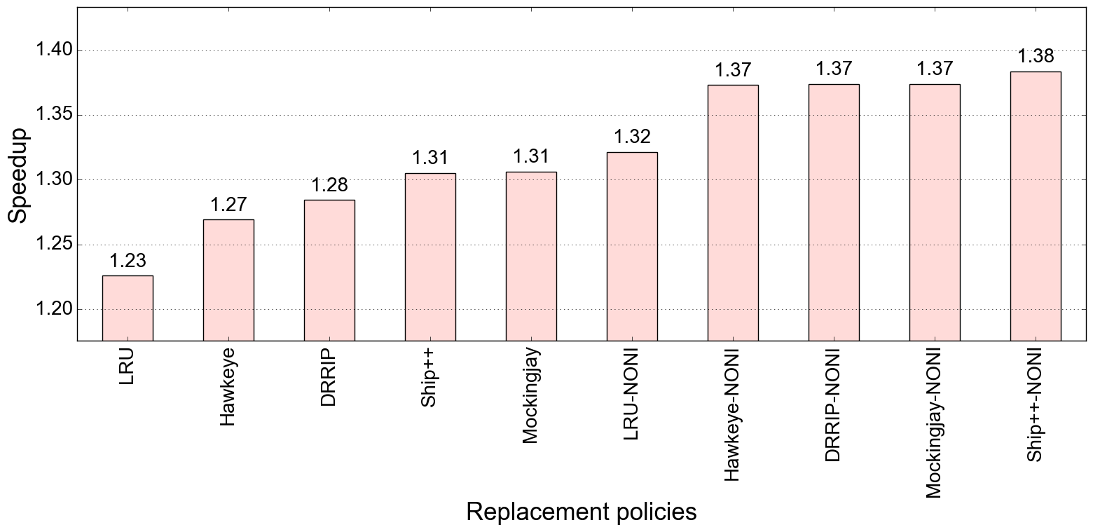
Performance improvement : IPCP (low DRAM BW, baseline: LRU, no pref)
Bench: SPEC 2017

Slide 3
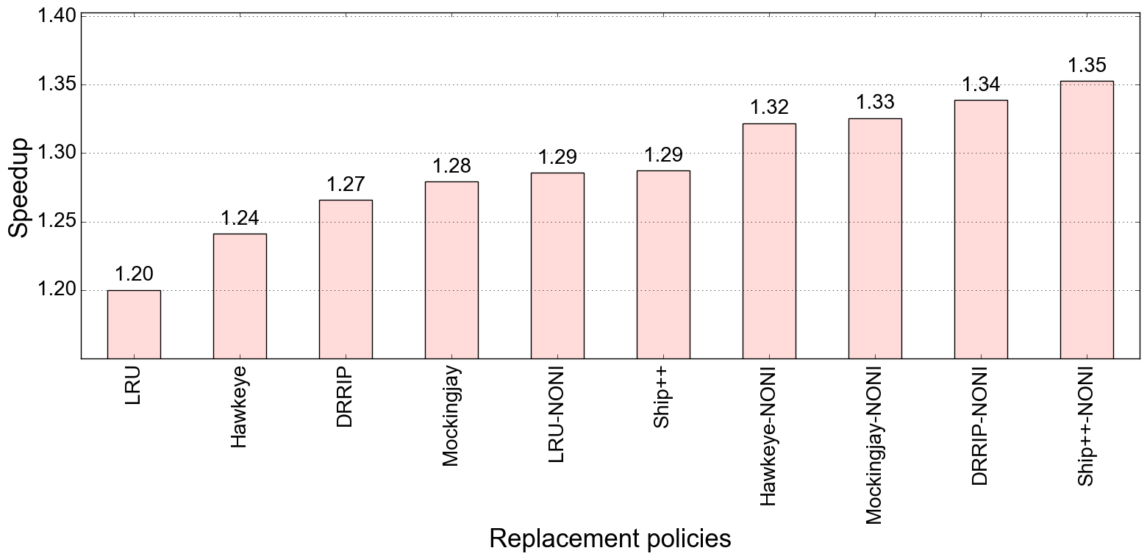
Performance improvement : Bingo (low DRAM BW , baseline: LRU, no pref)
Bench: SPEC 2017

Slide 4
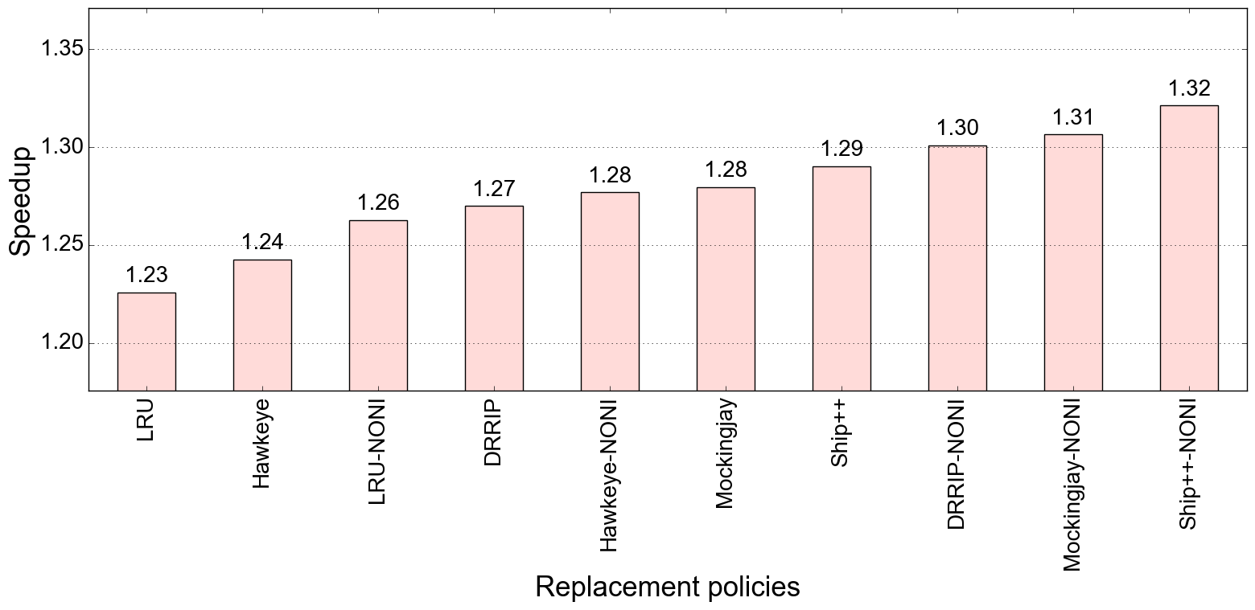
Performance improvement : SPP (low DRAM BW , baseline: LRU, no pref)
Bench: SPEC 2017

Slide 5
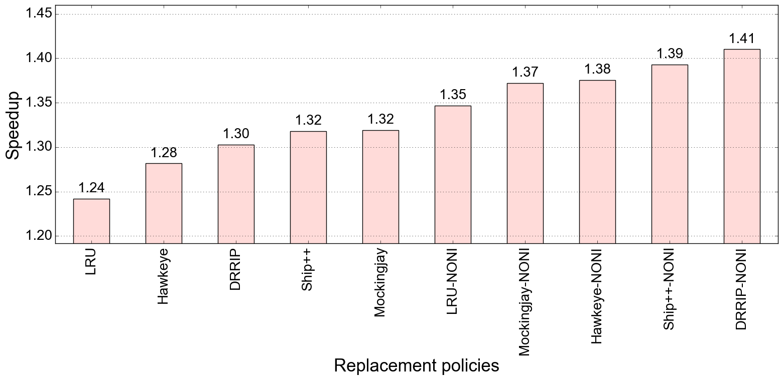
Performance improvement : IP-stride & Next-line (low DRAM BW , baseline: LRU, no pref)
Bench: SPEC 2017

Slide 6
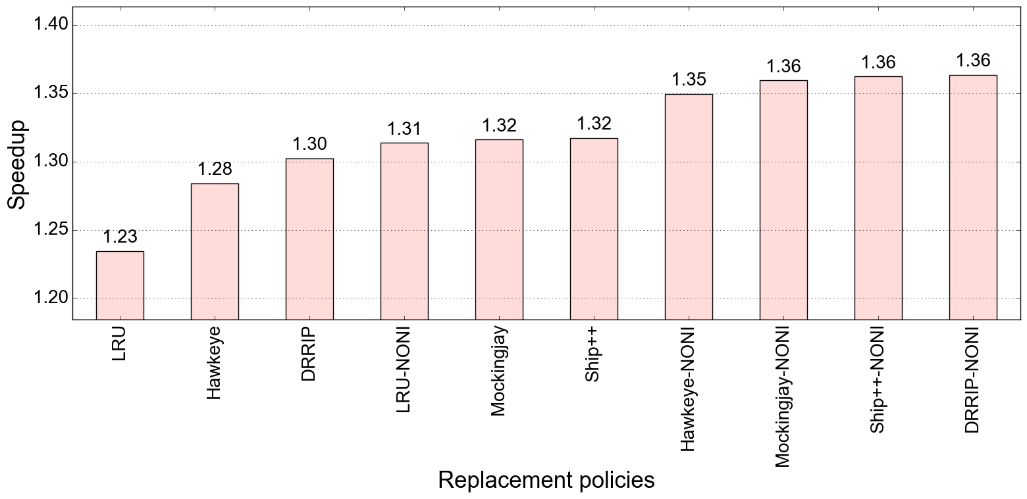
Performance improvement : IP-stride & Bingo (low DRAM BW , baseline: LRU, no pref)
Bench: SPEC 2017

Slide 7
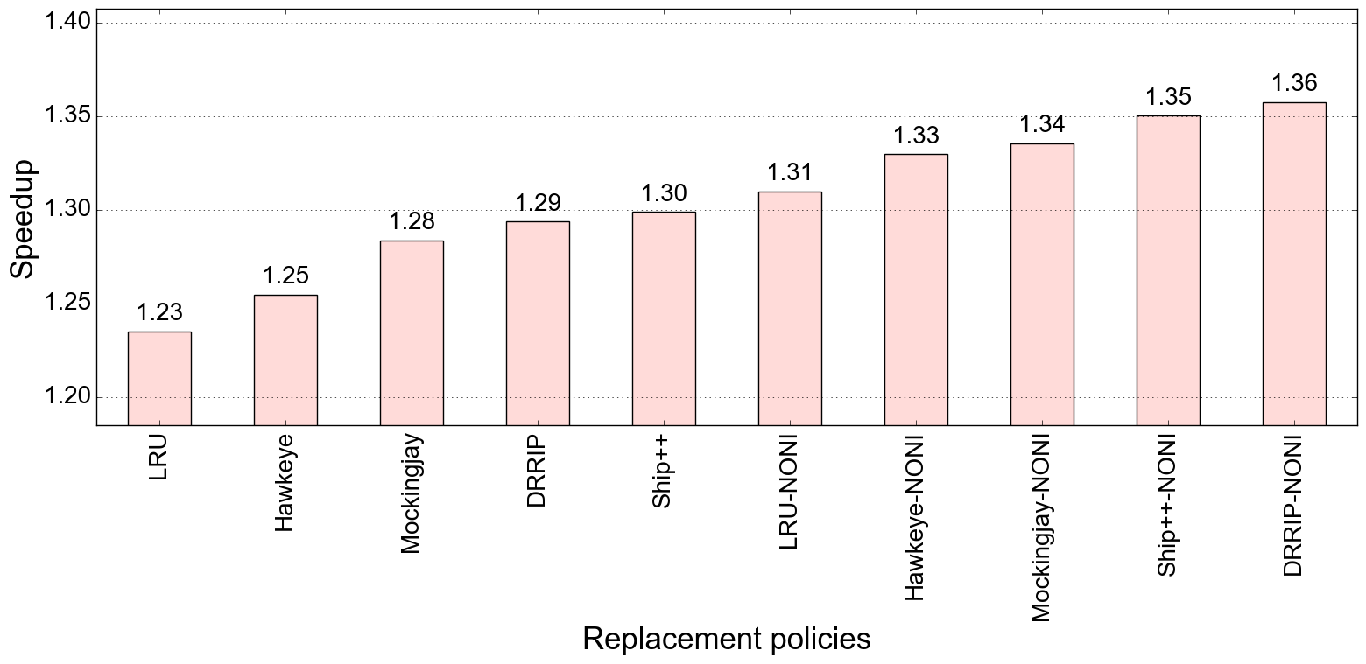
Performance improvement : IP-stride & SPP (low DRAM BW , baseline: LRU, no pref)
Bench: SPEC 2017

Slide 8
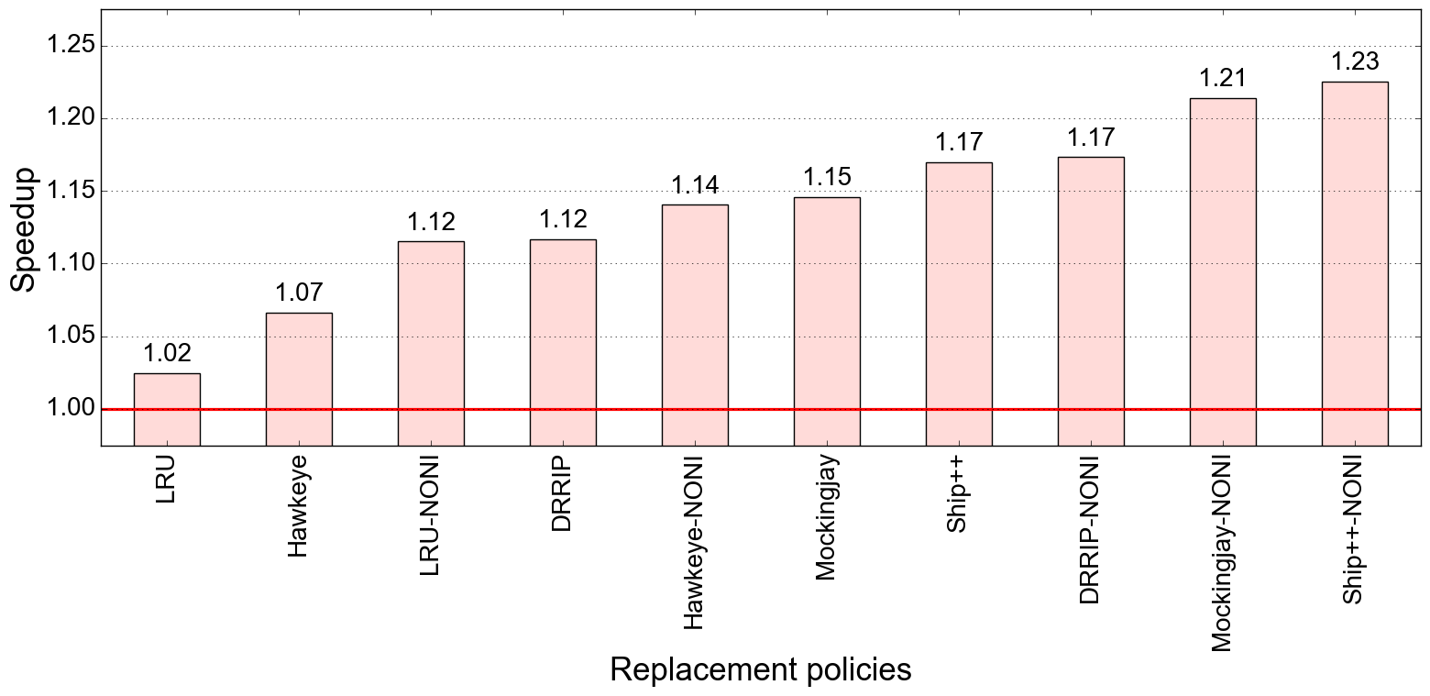
Performance improvement : IPCP (low DRAM BW, baseline: LRU, no pref)
Bench: GAP

Slide 9

Performance improvement : Bingo (low DRAM BW , baseline: LRU, no pref)
Bench: GAP

Slide 10
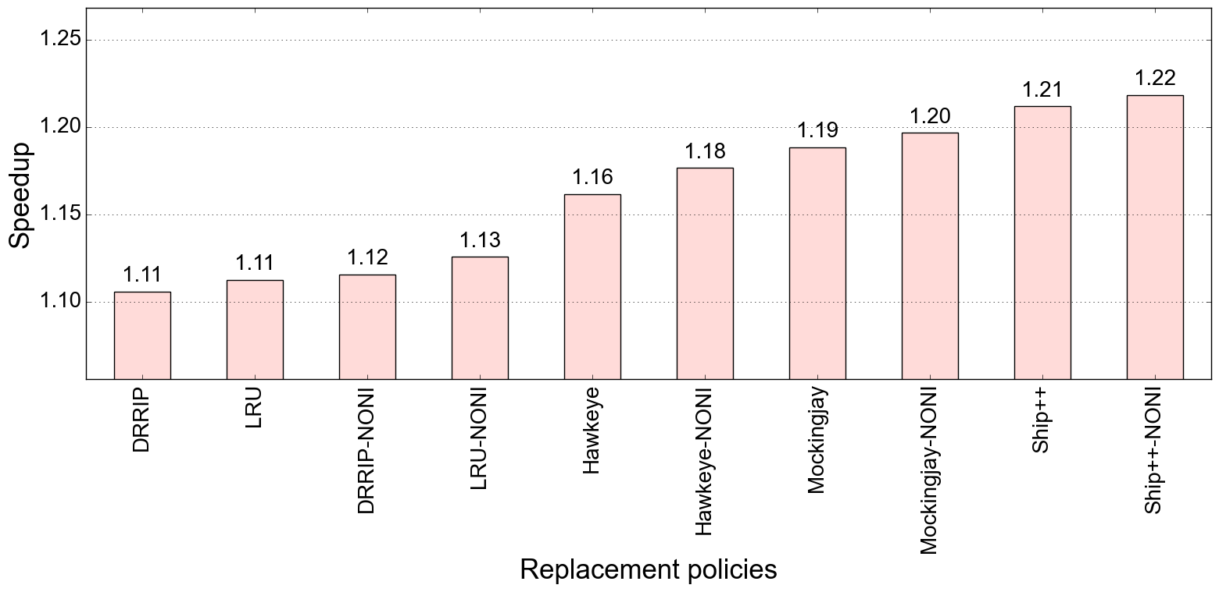
Performance improvement : SPP (low DRAM BW , baseline: LRU, no pref)
Bench: GAP

Slide 11
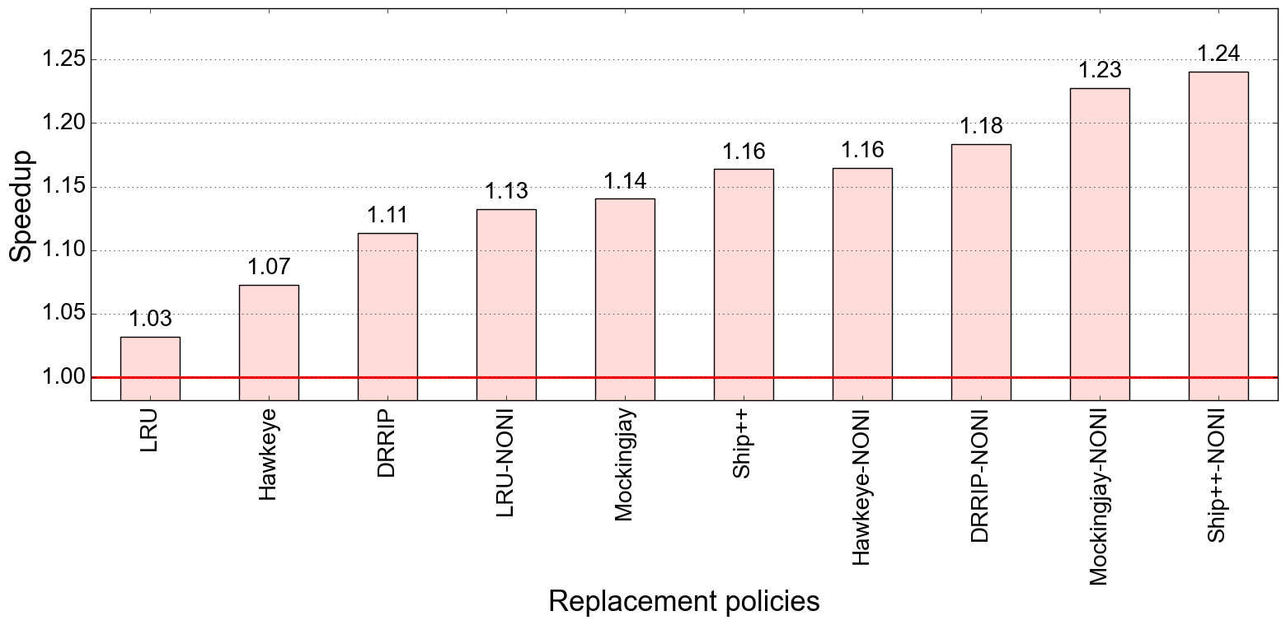
Performance improvement : IP-stride & Next-line (low DRAM BW , baseline: LRU, no pref)
Bench: GAP

Slide 12
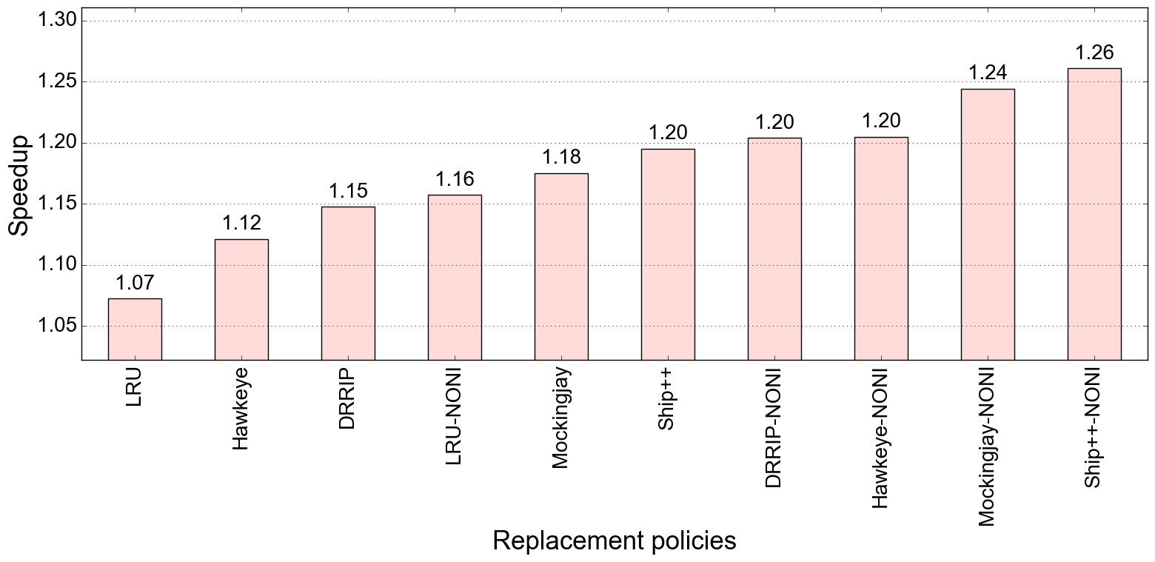
Performance improvement : IP-stride & Bingo (low DRAM BW , baseline: LRU, no pref)
Bench: GAP

Slide 13
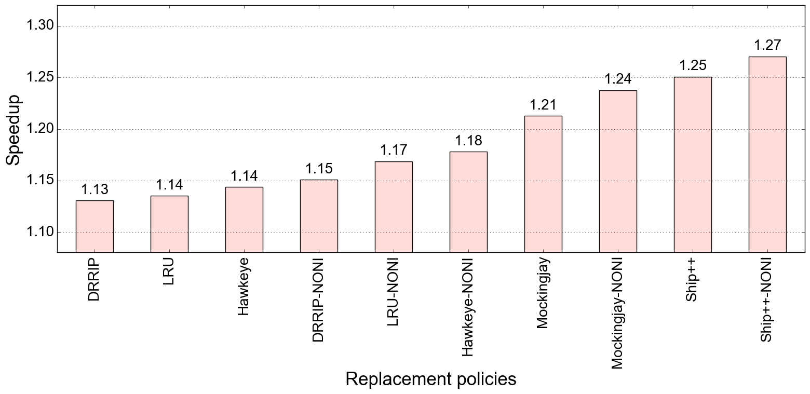
Performance improvement : IP-stride & SPP (low DRAM BW , baseline: LRU, no pref)
Bench: GAP

Slide 14
CASPER @ IIT Bombay
Weekly Discussion
Week of April 8, 2022
Jayati | Sumon jshrivastava@ee.iitr.ac.in | sumon@cse.iitb.ac.in

Slide 15
SPEC 2017

Slide 16
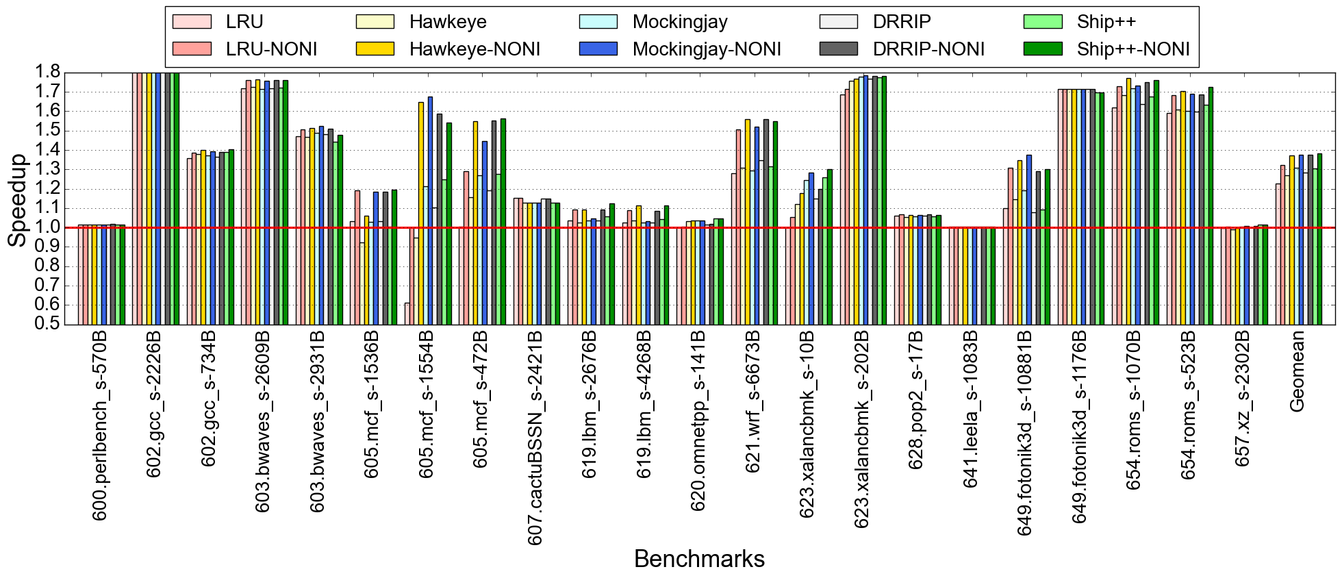
Performance improvement : IPCP (low DRAM BW, baseline: prefetcher OFF)
*NONI : no negative interactions

Slide 17
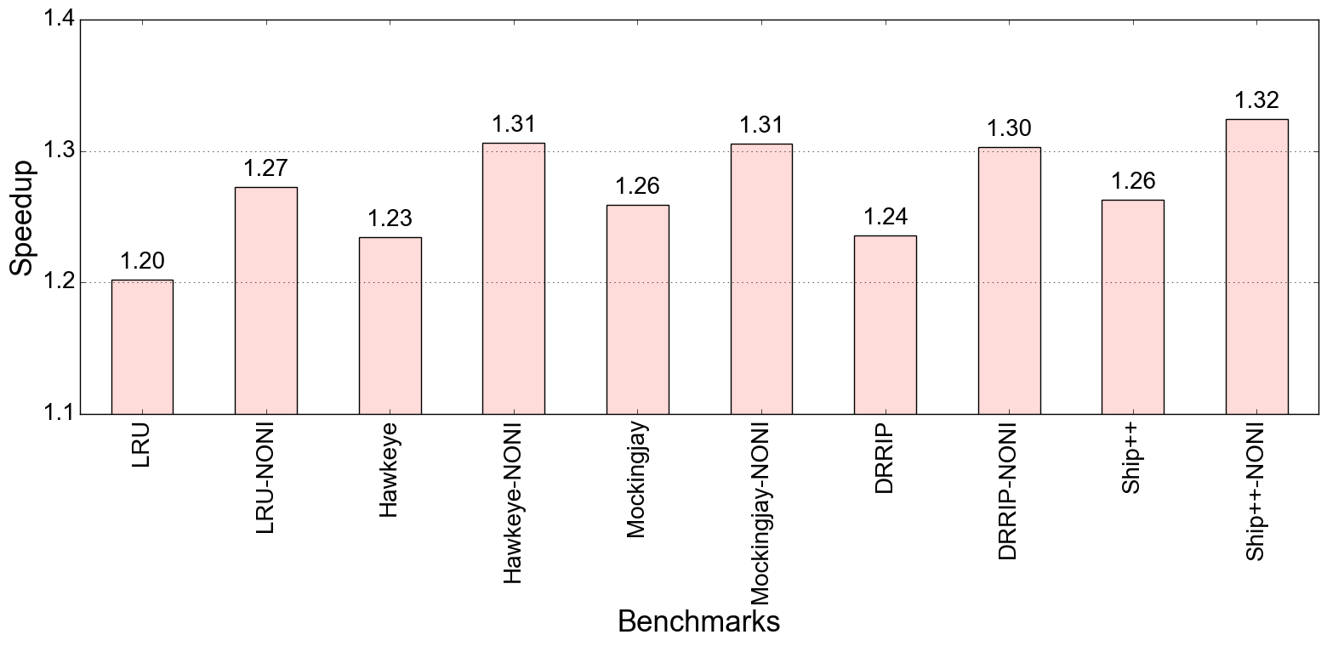
Performance improvement : IPCP (low DRAM BW, baseline: prefetcher OFF)

Slide 18
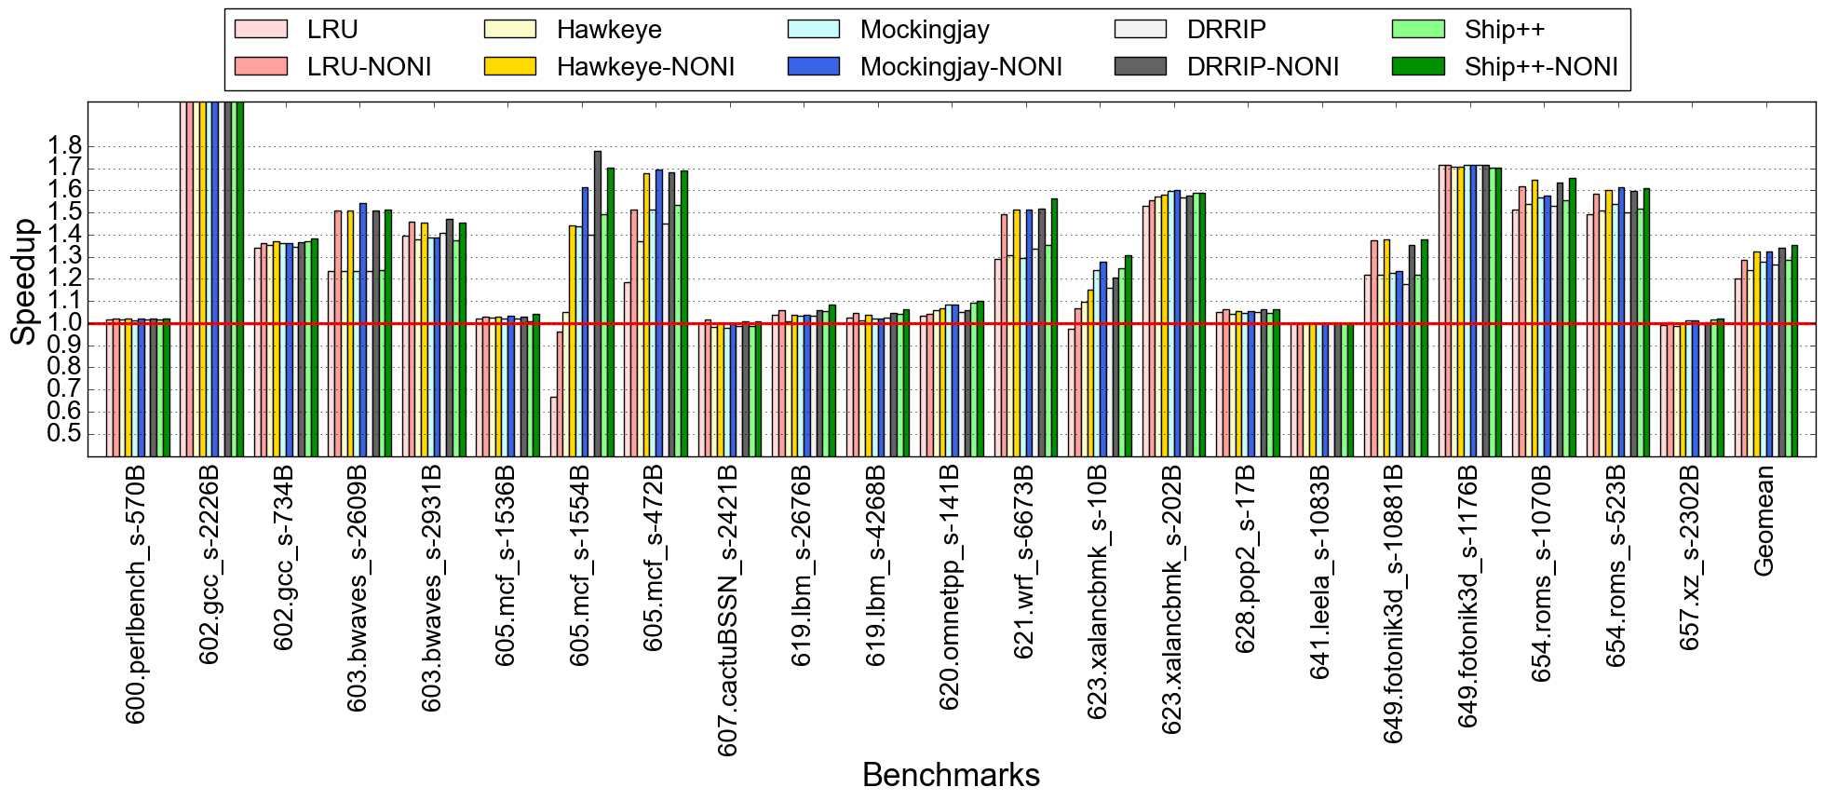
Performance improvement : Bingo (low DRAM BW , baseline: prefetcher OFF)

Slide 19
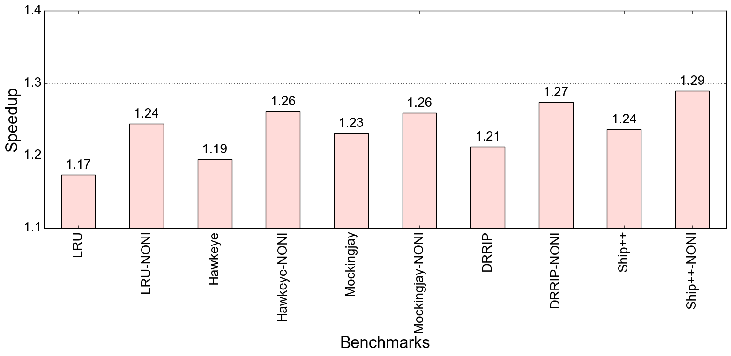
Performance improvement : Bingo (low DRAM BW , baseline: prefetcher OFF)

Slide 20
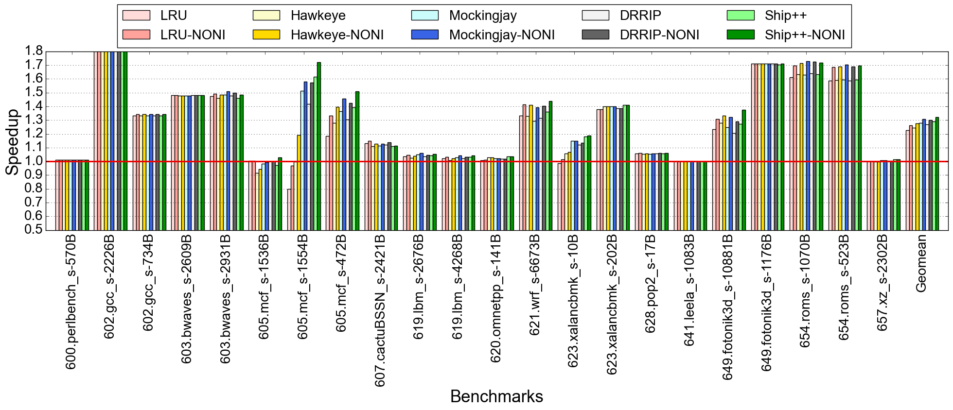
Performance improvement : SPP (low DRAM BW , baseline: prefetcher OFF)

Slide 21
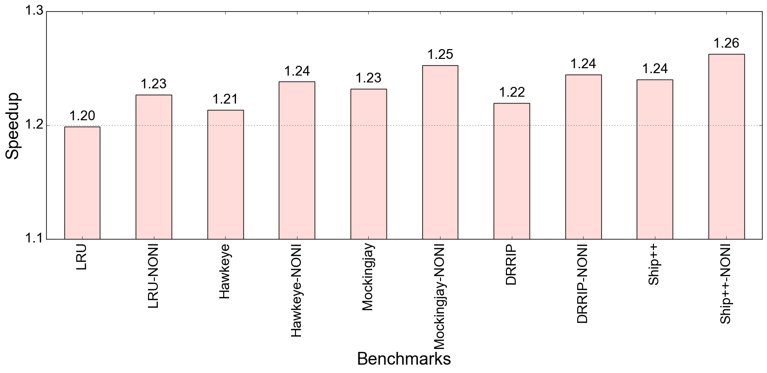
Performance improvement : SPP (low DRAM BW , baseline: prefetcher OFF)

Slide 22
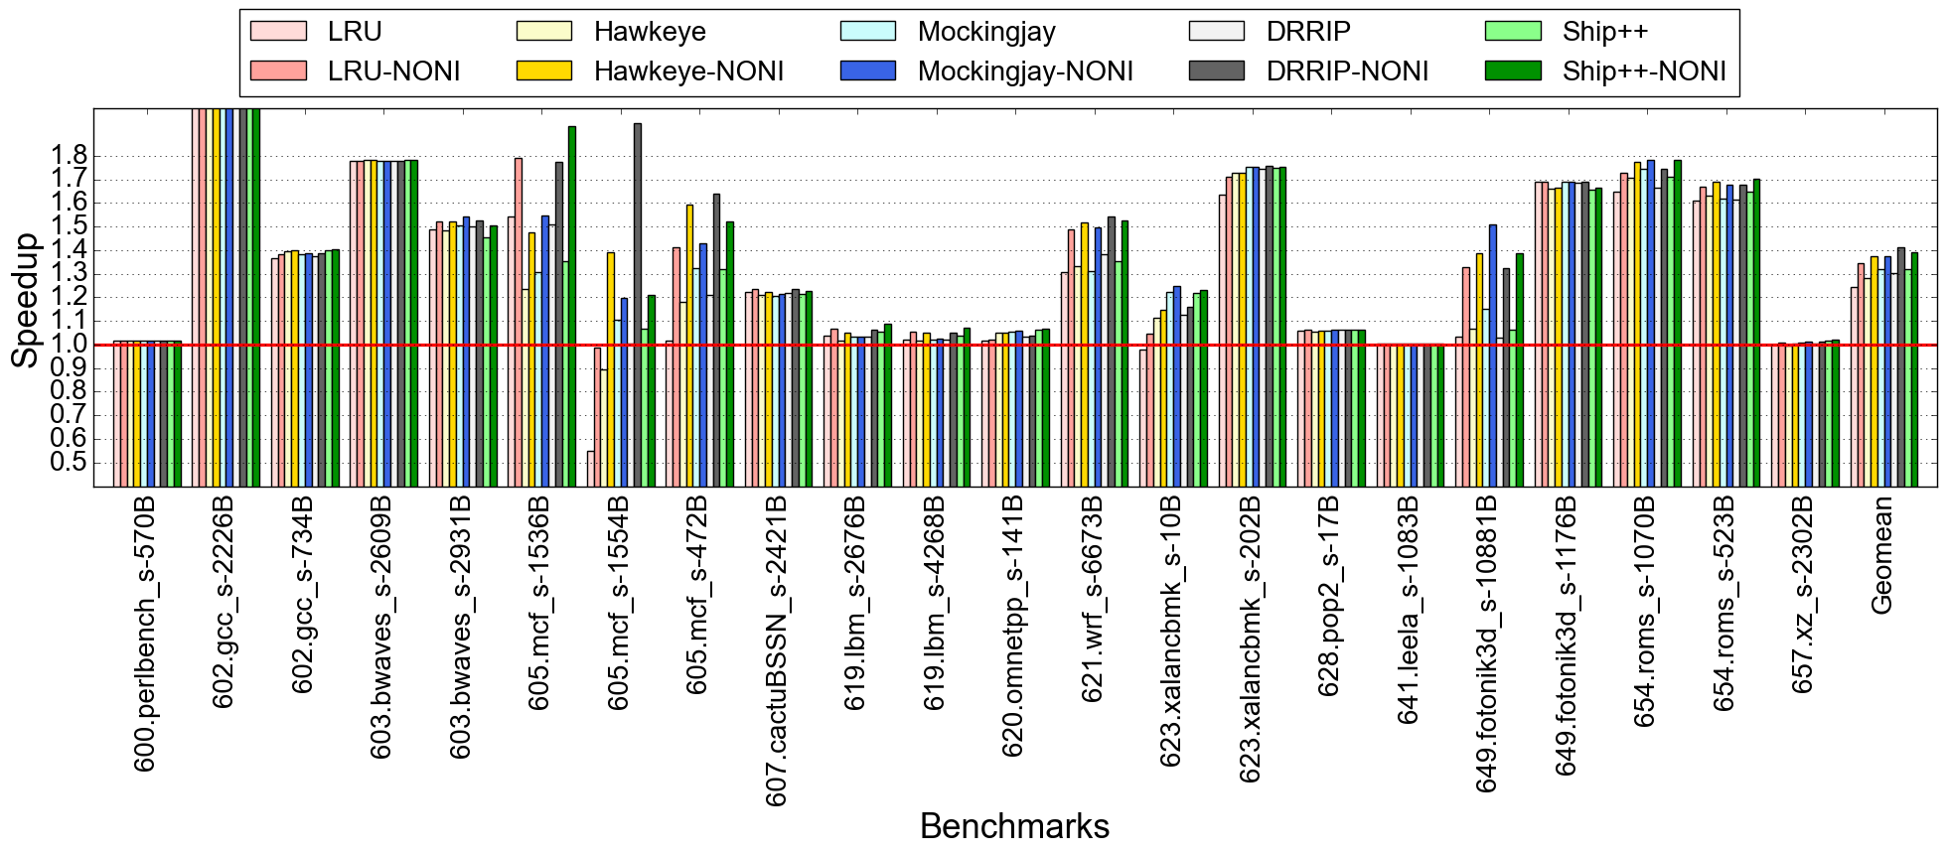
Performance improvement : IP-stride & Next-line (low DRAM BW , baseline: prefetcher OFF)

Slide 23
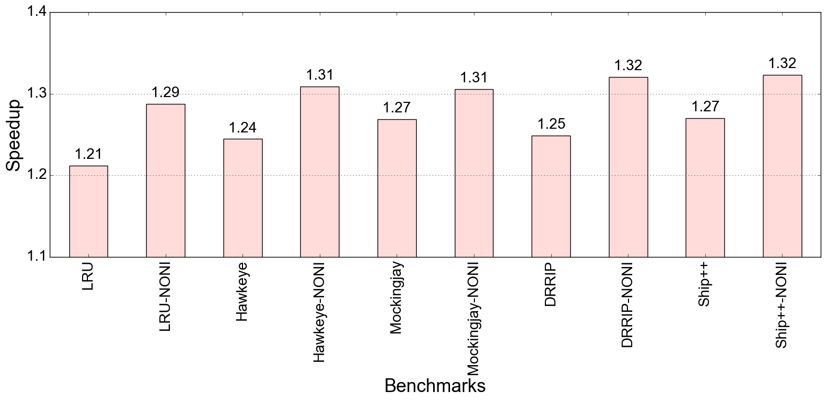
Performance improvement : IP-stride & Next-line (low DRAM BW , baseline: prefetcher OFF)

Slide 24
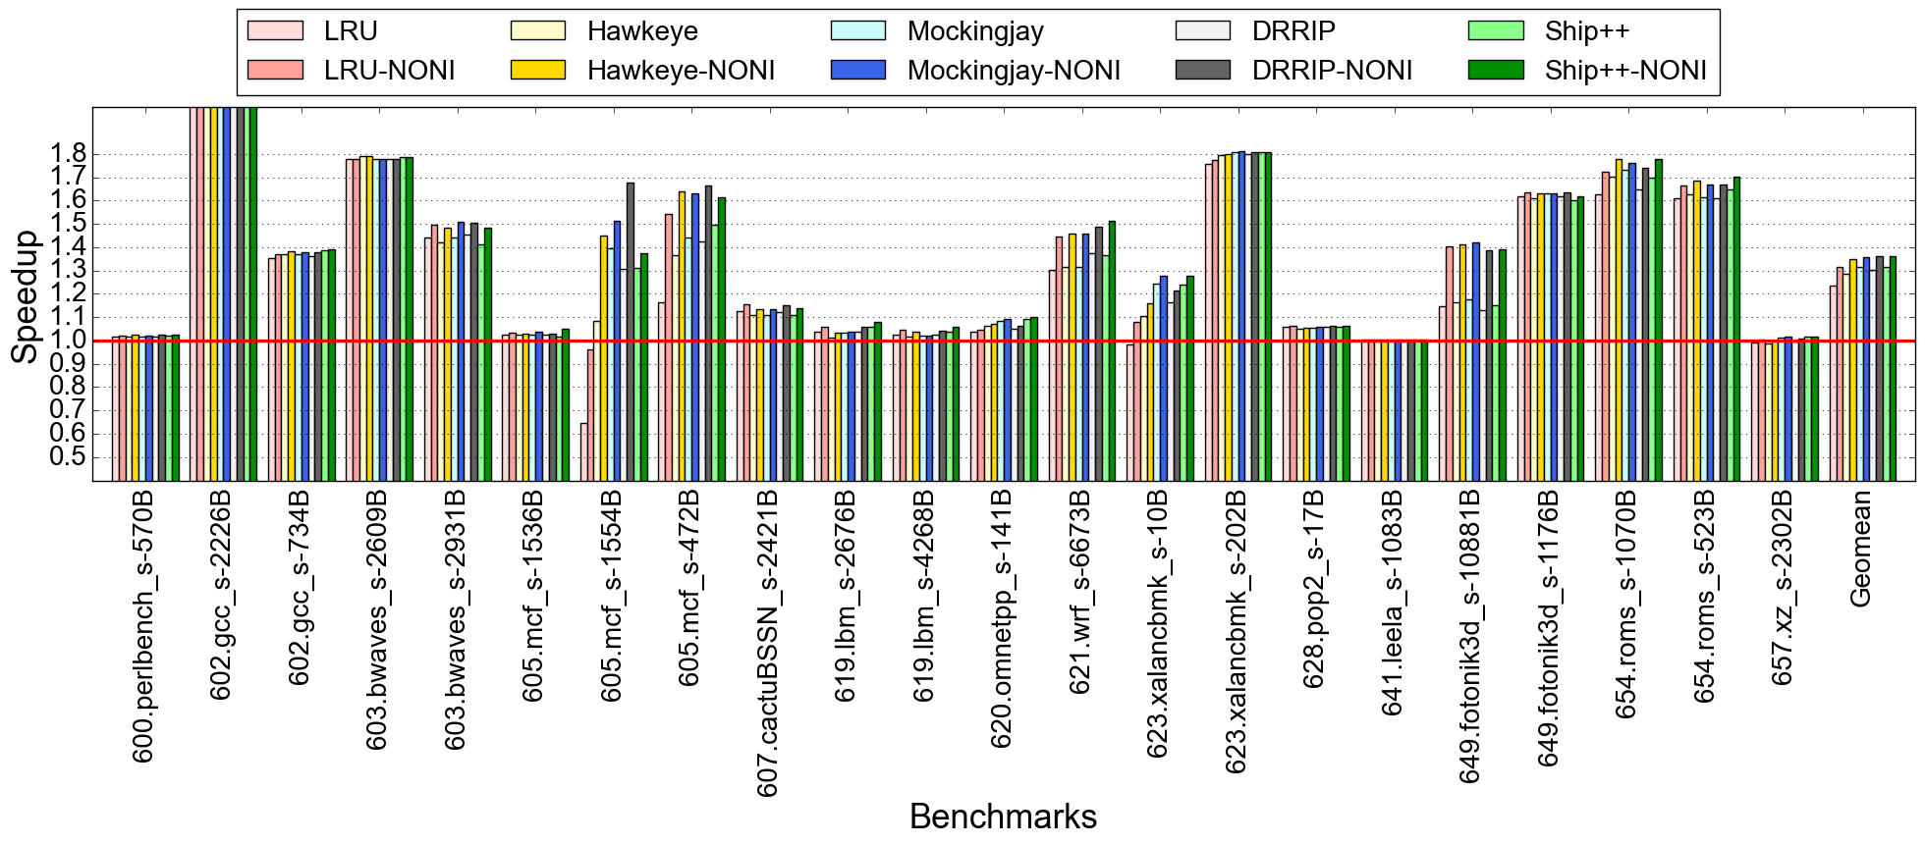
Performance improvement : IP-stride & Bingo (low DRAM BW , baseline: prefetcher OFF)

Slide 25
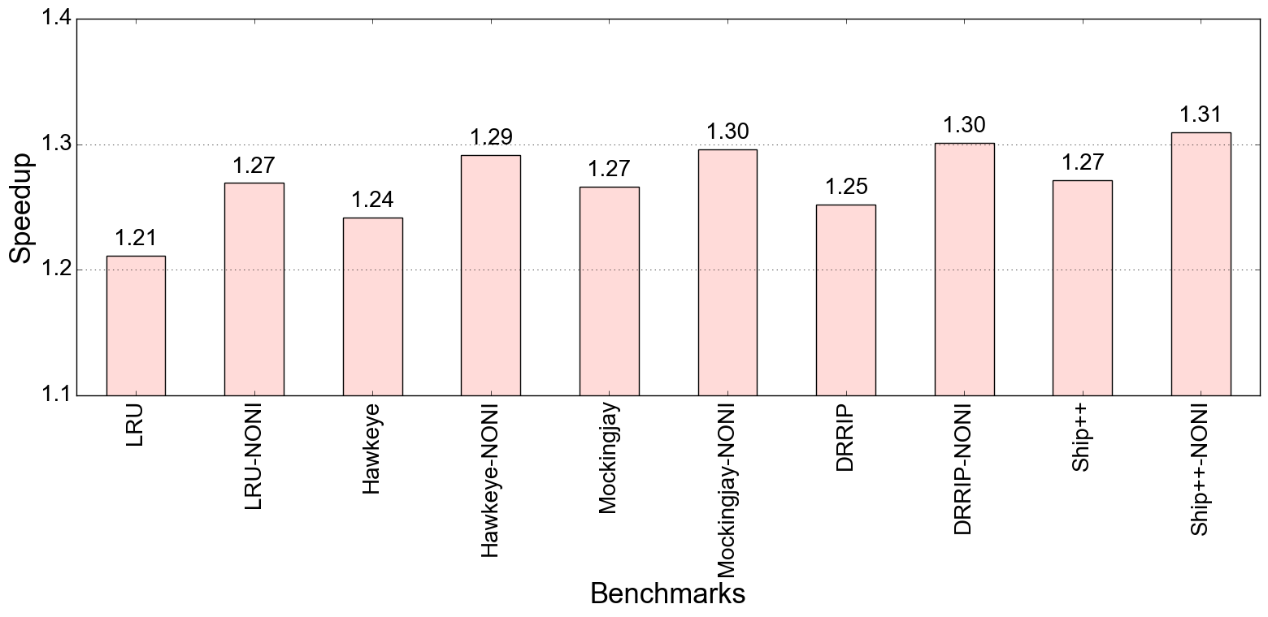
Performance improvement : IP-stride & Bingo (low DRAM BW , baseline: prefetcher OFF)

Slide 26
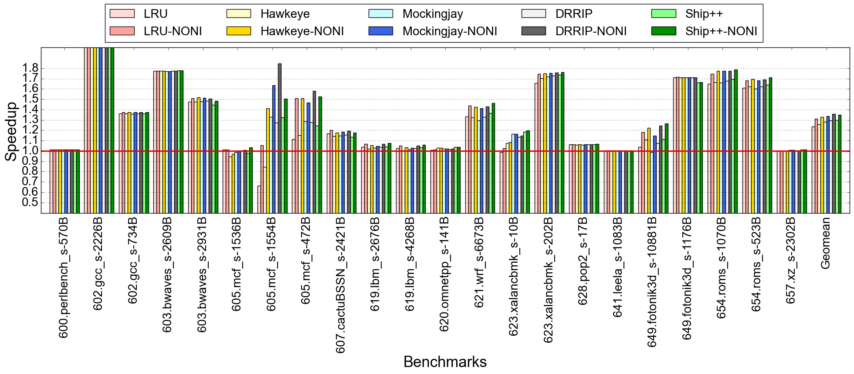
Performance improvement : IP-stride & SPP (low DRAM BW , baseline: prefetcher OFF)

Slide 27
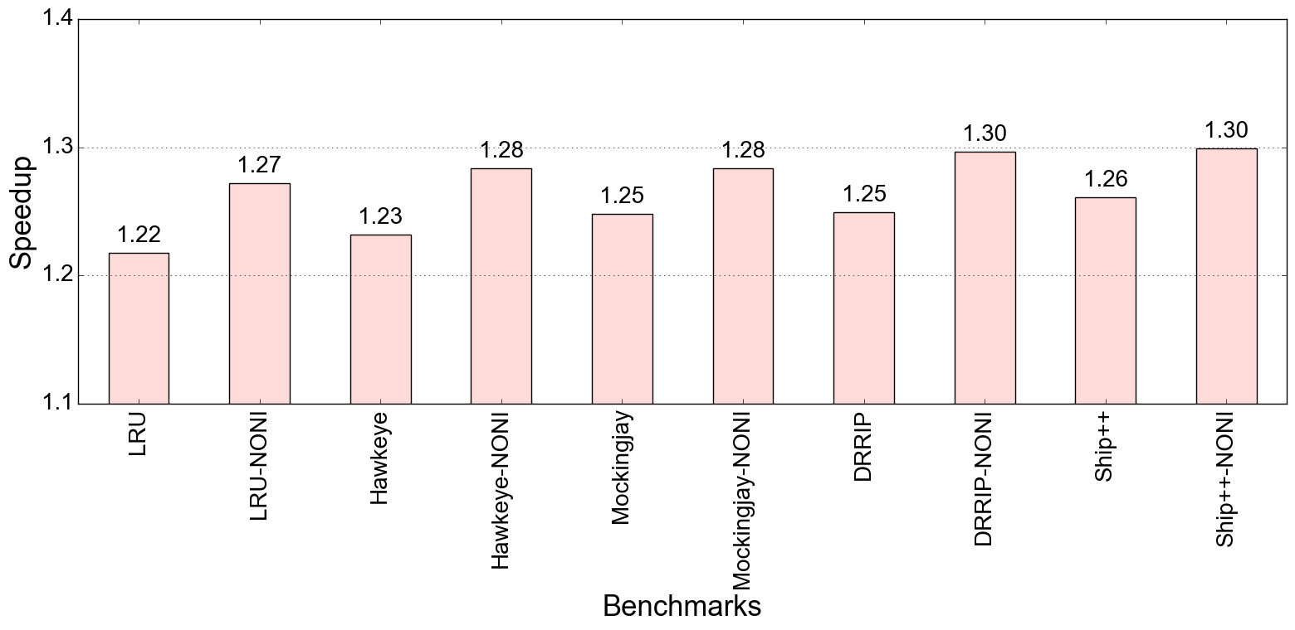
Performance improvement : IP-stride & SPP (low DRAM BW , baseline: prefetcher OFF)

Slide 28
GAP

Slide 29
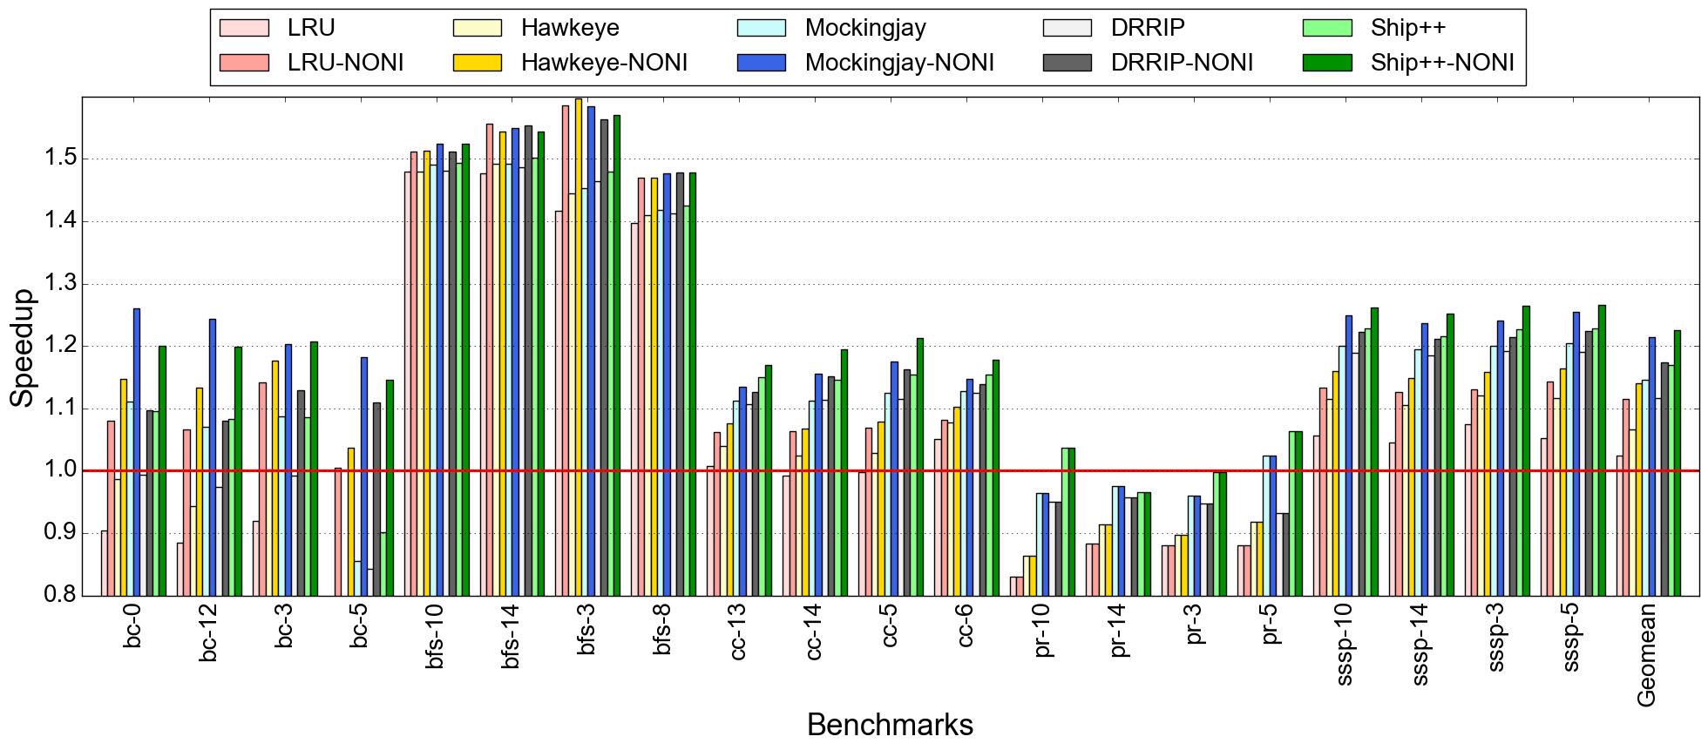
Performance improvement : IPCP (low DRAM BW , baseline: prefetcher OFF)

Slide 30
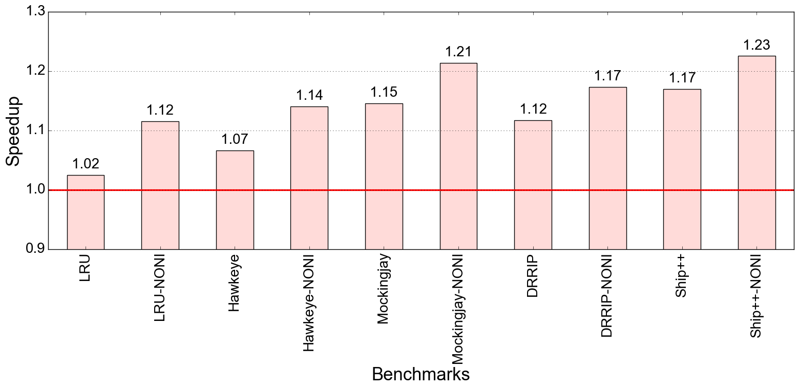
Performance improvement : IPCP (low DRAM BW , baseline: prefetcher OFF)

Slide 31
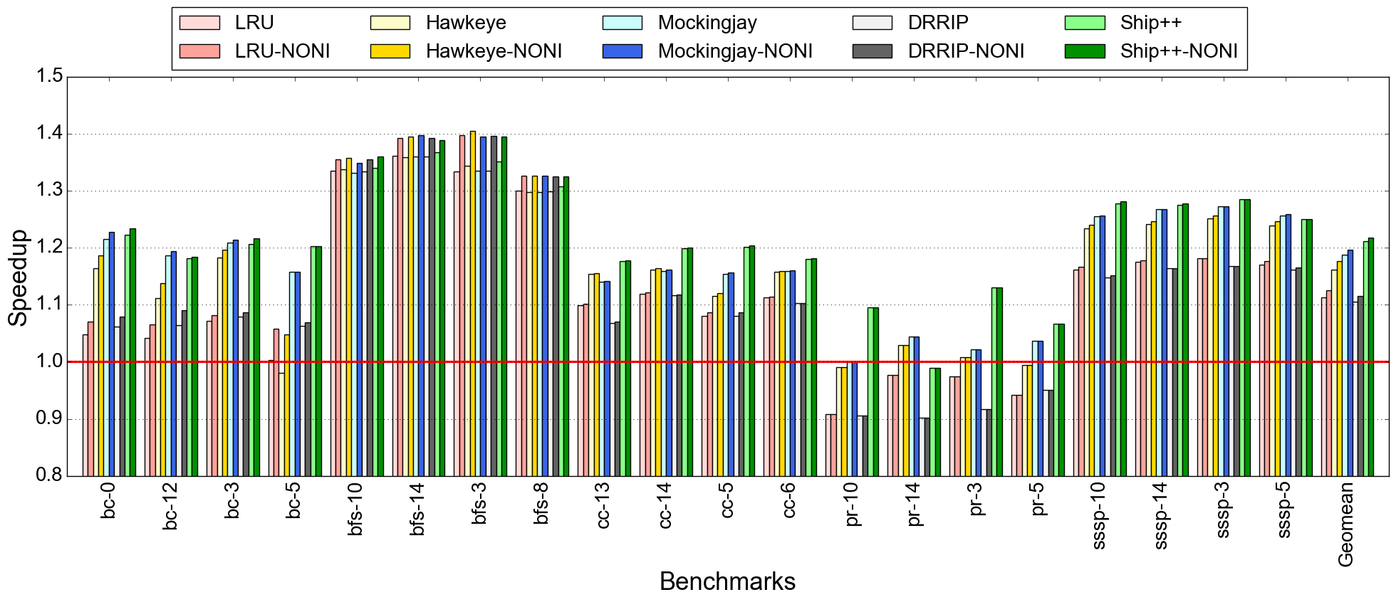
Performance improvement : SPP (low DRAM BW , baseline: prefetcher OFF)

Slide 32
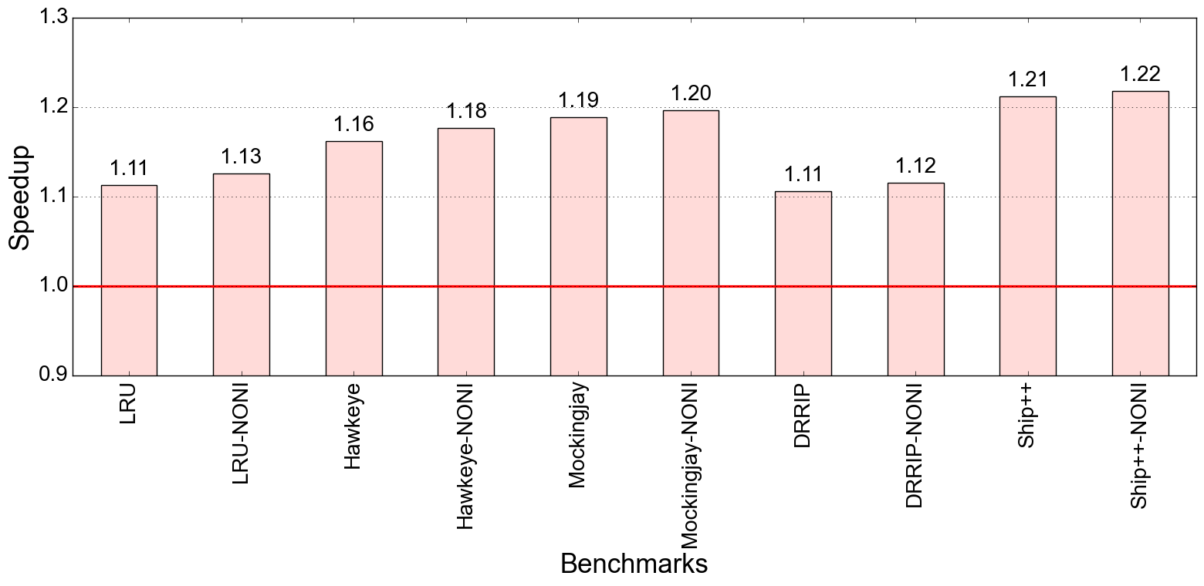
Performance improvement : SPP (low DRAM BW , baseline: prefetcher OFF)

Slide 33
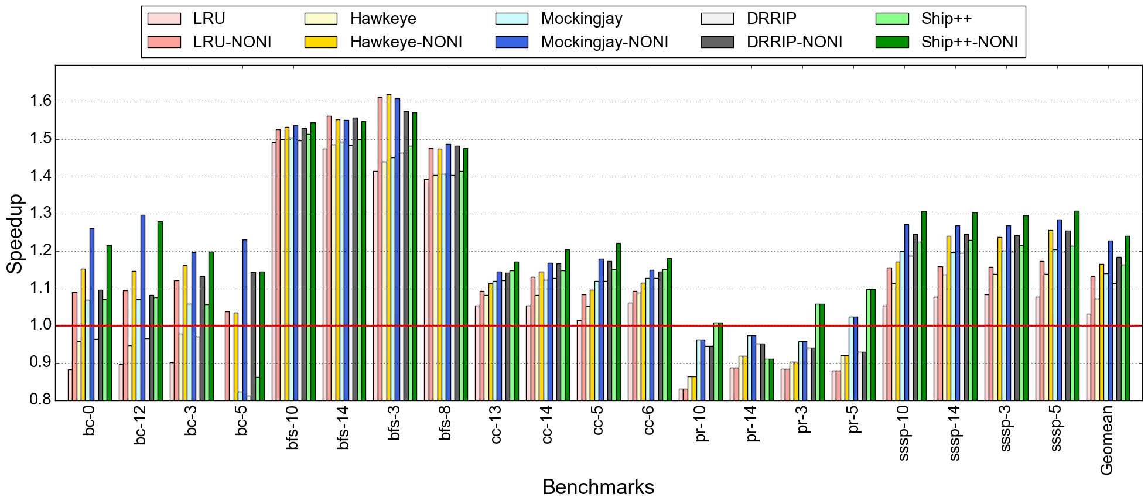
Performance improvement : IP-stride & Next-line (low DRAM BW , baseline: prefetcher OFF)

Slide 34
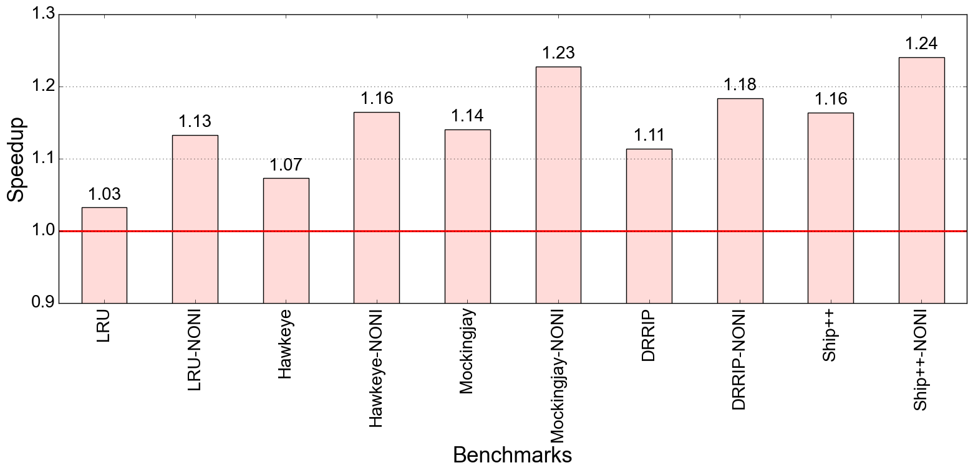
Performance improvement : IP-stride & Next-line (low DRAM BW , baseline: prefetcher OFF)

Slide 35
Todos
Few gap bench experiments are running
Multicore experiments with homogenous & heterogenous mixes

Slide 36
CASPER @ IIT Bombay
Weekly Discussion
Week of April 1, 2022
Jayati | Sumon jshrivastava@ee.iitr.ac.in | sumon@cse.iitb.ac.in

Slide 37
Work done
Ran experiments with different prefetchers and replacement policies

Slide 38
Experiment method
DRAM Bandwidth: 800 MT/s
Baseline: respective prefetcher ON
Experiment: Speedup for diff. prefetchers with no negative interaction with a fixed replacement policy at LLC
Negative interactions eliminated at L2 & LLC

Slide 39
Speedup: replacement policy used - LRU
Geomean: IPCP - 5.9% Bingo - 6% SPP - 2.3% IP-STRIDE & NL - 6.2%

Slide 40
Speedup: replacement policy used - DRRIP
Geomean: IPCP - 5.9% SPP - 2.2% IP STRIDE & NL - 6.37%

Slide 41
Speedup: replacement policy used - Hawkeye
Geomean: IPCP - 6.15% SPP - 2.1% IP STRIDE & NL - 5.6%

Slide 42
Speedup: replacement policy used - Mockingjay
Geomean: IPCP - 4.16% SPP - 1.82% IP STRIDE & NL - 3.7%

Slide 43
Speedup: replacement policy used - Ship++
Geomean: IPCP - 5.5% SPP - 1.9% IP STRIDE & NL - 4.76%

Slide 44
Experiment method
DRAM Bandwidth: 800 MT/s
Baseline: respective prefetcher ON
Experiment: Speedup for a fixed prefetchers with no negative interaction with a diff. replacement policy at LLC
Negative interactions eliminated at L2 & LLC

Slide 45
Speedup: prefetcher used - IPCP(L1D & L2)
Geomean: LRU - 5.9% Hawkeye - 6.15% Mockingjay - 4.16% DRRIP - 5.88% Ship++ - 5.55 %

Slide 46
Speedup: prefetcher used - SPP
Geomean: LRU - 2.3% Hawkeye - 2.13% Mockingjay - 1.8% DRRIP - 2.2% Ship++ - 1.9 %

Slide 47
Speedup: prefetcher used - IP-stride(L1D), NL(L2)
Geomean: LRU - 6.2% Hawkeye - 5.6% Mockingjay - 3.7% DRRIP - 6.37% Ship++ - 4.76 %

Slide 48
CASPER @ IIT Bombay
Weekly Discussion
Week of March 25, 2022
Jayati | Sumon jshrivastava@ee.iitr.ac.in | sumon@cse.iitb.ac.in

Slide 49
Work done
Re-ran experiments to get correct numbers
Ran experiments with different prefetchers and replacement policies(plots pending)

Slide 50
Configuration
DRAM bandwidth: 800 MT/s
Prefetcher: IPCP (L1D, L2)
Replacement policy: LRU

Slide 51
Performance improvement : no neg interactions
~62%
Geomean: 5.2 %
Baseline: Prefetcher on (IPCP)

Slide 52
Performance improvement : no neg interactions
IPCP(with neg): 20%
IPCP(no neg) : 26%
Ideal : 78%
Baseline: No prefetcher

Slide 53
CASPER @ IIT Bombay
Weekly Discussion
Week of March 18, 2022
Jayati | Sumon jshrivastava@ee.iitr.ac.in | sumon@cse.iitb.ac.in

Slide 54
Work done
Low dram bandwidth experiments & analysis
Sensitivity analysis: Change in interaction with varying window size

Slide 55
High dram bandwidth (6400 MT/s) experimental results

Slide 56
Performance improvement : no neg interactions
Baseline: With respective prefetcher on

Slide 57
Performance improvement : no neg interactions
Baseline: With prefetcher off

Slide 58
Amortized Miss Penalty
$$LLC amortized miss penalty= \frac{avg miss penalty with prefetcher − avg miss penalty without prefetcher}{avg MSHR occupancy}$$

Slide 59
Neg interactions per kilo instructions
High NPKI & high amortized LLC miss penalty -> high speedup

Slide 60
Pos interactions per kilo instructions
Very low PPKI for IPCP

Slide 61
Pos interactions per kilo instructions
High PPKI ~ low speedup for SPP

Slide 62
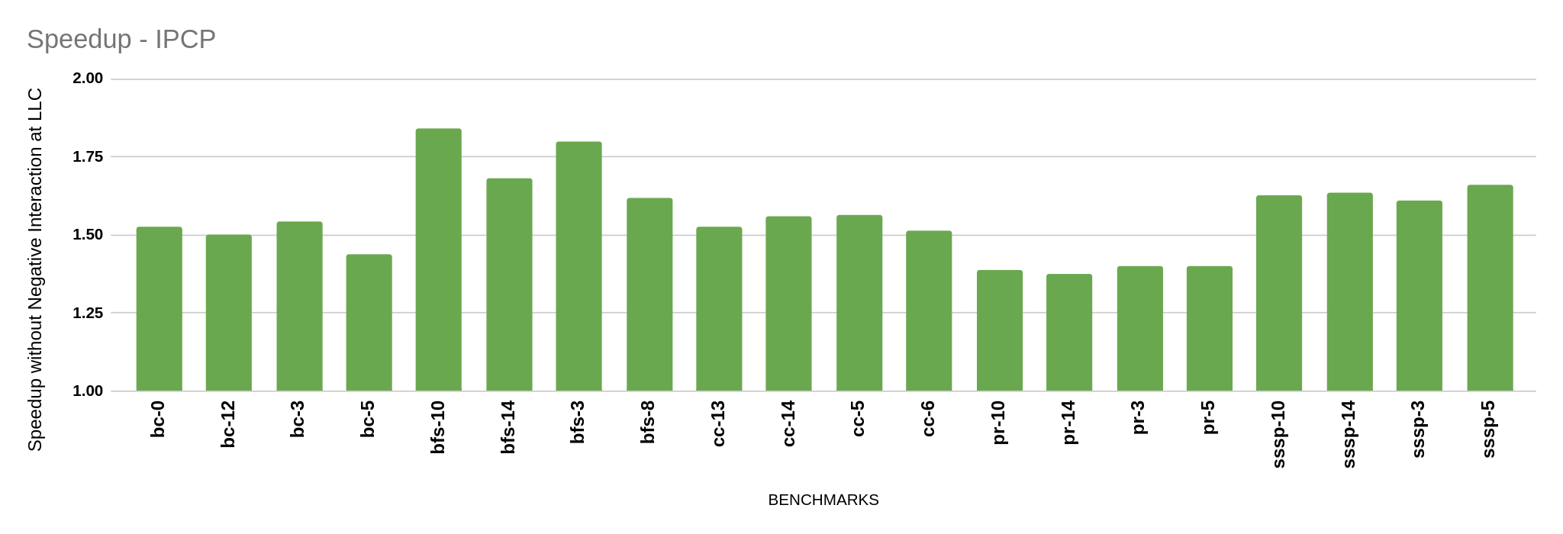
GAP Benchmarks – IPCP Performance Improvement
Performance Improvement is observed for all GAP Benchmarks, IPCP shows higher speedup than SPP
Baseline: With prefetcher ON
AVG: 1.56

Slide 63
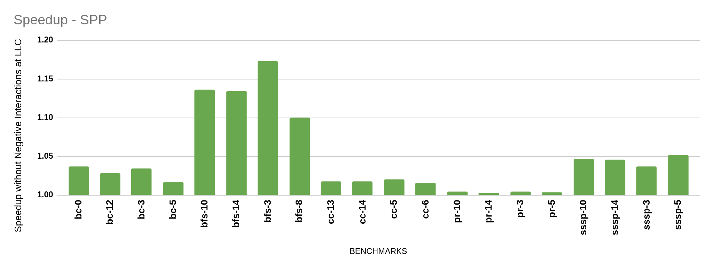
GAP Benchmarks – SPP Performance Improvement
Baseline: With prefetcher ON
AVG: 1.04

Slide 64
Low dram bandwidth (800 MT/s) experimental results

Slide 65
Performance improvement : no neg interactions
Baseline: With respective prefetcher on

Slide 66
Performance improvement : no neg interactions
Baseline: With prefetcher off

Slide 67
Amortized Miss Penalty
Higher miss penalty in case of low dram bandwidth

Slide 68
Neg interactions per kilo instructions
NPKI, PPKI remains same with varying dram bandwidth

Slide 69
Pos interactions per kilo instructions
NPKI, PPKI remains same with varying dram bandwidth

Slide 70
Pos interactions per kilo instructions
NPKI, PPKI remains same with varying dram bandwidth

Slide 71
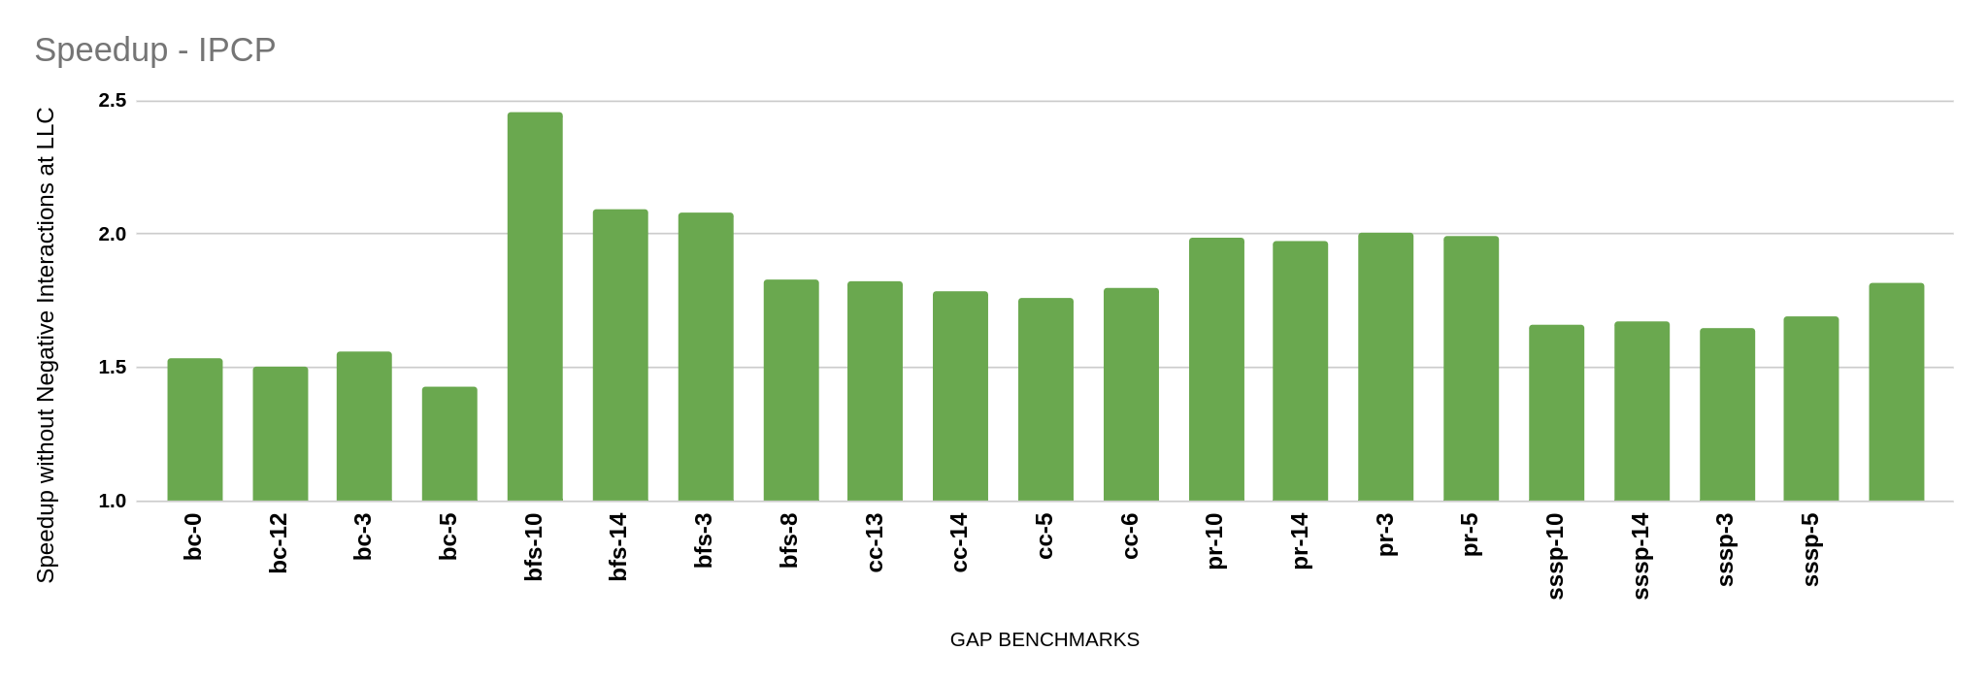
GAP Benchmarks – IPCP Performance Improvement
Speedup at 800 MT/s is higher than at 6400 MT/s
Baseline: With prefetcher ON
AVG: 1.81

Slide 72
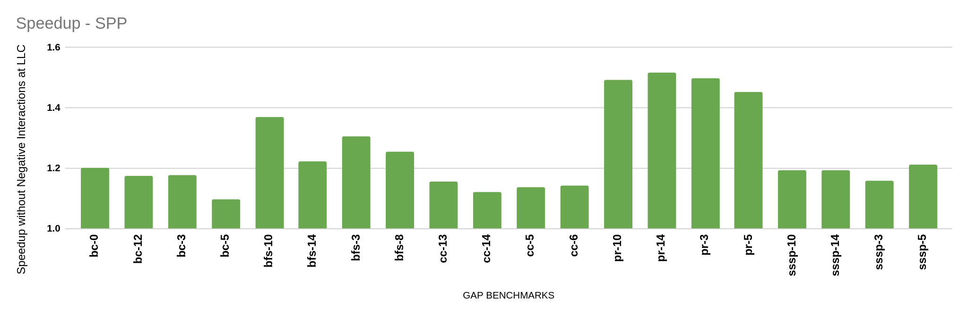
GAP Benchmarks – SPP Performance Improvement
Speedup at 800 MT/s is higher than at 6400 MT/s
Baseline: With prefetcher ON
AVG: 1.25

Slide 73
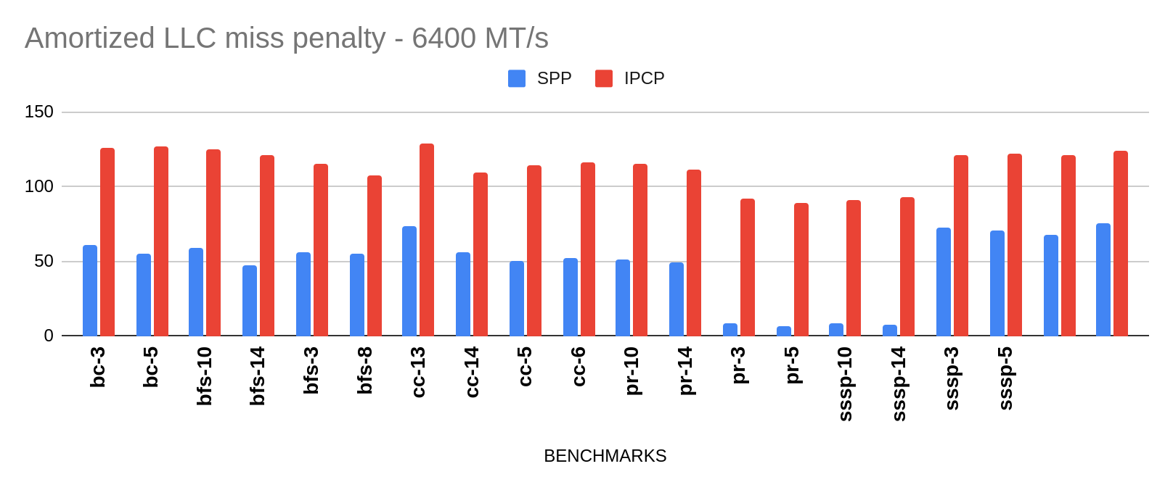
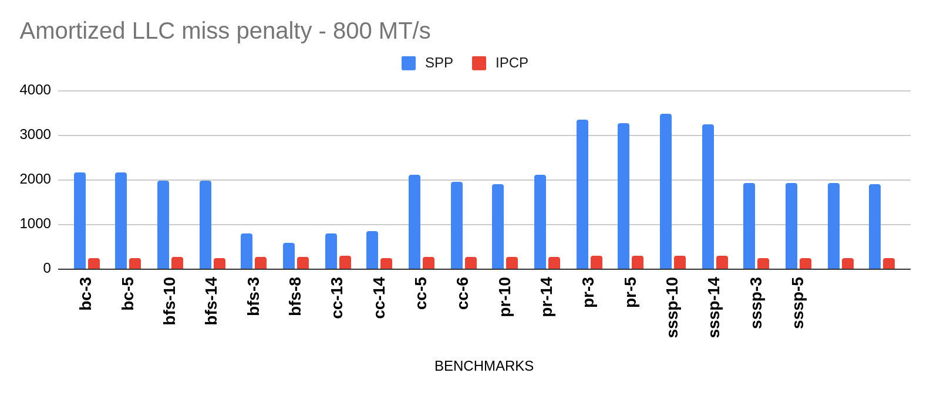
Why the reversal of trends?
At 6400 MT/s, IPCP gives higher miss latency than SPP, but at 800 MT/s SPP has significantly higher miss latency than IPCP. In both cases, IPCP has higher NPKI, MPKI, avg MSHR occupancy

Slide 74
Size of interaction window: sensitivity analysis
Prefetcher : IPCP
Replacement policy: LRU

Slide 75
Interactions at L1D with varying window size
High variation for cactu with increasing window size

Slide 76
Interactions at L2C with varying window size
Interaction % remains constant with varying window size

Slide 77
Interactions at LLC with varying window size
Interaction % remains constant with varying window size

Slide 78
CASPER @ IIT Bombay
Weekly Discussion
Week of March 11, 2022
Jayati | Sumon jshrivastava@ee.iitr.ac.in | sumon@cse.iitb.ac.in

Slide 79
Work done
Jayati:
made interaction plots for bingo
dynamic epoch size in terms of MPKI (pending fix)
Sumon
Fixed speedup numbers(using MLP)

Slide 80
Speedup with no neg interaction at LLC
Prefetcher used at L1, L2 : IPCP
Replacement policy used at LLC: LRU
Geomean: 6.9%

Slide 81
Interactions at LLC
Prefetcher used at L1, L2 : IPCP
Replacement policy used at LLC: LRU
solution: LLC bypass

Slide 82
Speedup with no neg interaction at LLC
Prefetcher used at L2 : SPP
Replacement policy used at LLC: LRU
Geomean: 1.8%

Slide 83
Interactions at LLC
Prefetcher used at L2 : SPP
Replacement policy used at LLC: LRU

Slide 84
Problem benchmarks
Reason: Penalty cycle is negative

Slide 85
Low DRAM Bandwidth Evaluation
DRAM bandwidth : 1600 MT/s

Slide 86
Low DRAM Bandwidth Evaluation

Slide 87
Todo
Address the issue where penalty is decreasing for some benchmarks
Experiments with low DRAM bandwidth

Slide 88
CASPER @ IIT Bombay
Weekly Discussion
Week of February 25, 2021
Jayati | Sumon jshrivastava@ee.iitr.ac.in | sumon@cse.iitb.ac.in

Slide 89
Work done
Jayati: scripts to extract IPC when penalty due to negative interactions are ignored.
Sumon: modified the scripts to fit the use-case

Slide 90
Performance improvement with no neg. interaction
Prefetcher used at L1, L2 : IPCP
Replacement policy used at LLC: LRU
~ 14% improvement

Slide 91
Relative number of negative interactions
Prefetcher used at L1, L2 : IPCP
Replacement policy used at LLC: LRU

Slide 92
Performance improvement with no neg. interaction
Concerns
Ignored miss penalty at L1D.
Miss penalty decreases with prefetcher for some benchmarks

Slide 93
Performance improvement with no neg. interaction
Prefetcher used at L2 : SPP
Replacement policy used at LLC: LRU
~ 9% improvement

Slide 94
Relative number of negative interactions
Prefetcher used at L2 : SPP
Replacement policy used at LLC: LRU

Slide 95
Performance improvement with no neg. interaction
Concerns
Miss penalty decreases with prefetcher for some benchmarks

Slide 96
Approach
Penalty cycles at a cache level = (# of neg. interactions) * (avg. miss latency at the cache level with prefetcher - avg. miss latency at the cache level without prefetcher)
Total penalty cycles = Σ of penalty cycles at all cache levels
Ideal IPC = # of sim. instructions /(# of cpu cycles - total penalty cycles)

Slide 97
CASPER @ IIT Bombay
Weekly Discussion
Week of Febraury 18, 2021
Jayati | Sumon jshrivastava@ee.iitr.ac.in | sumon@cse.iitb.ac.in

Slide 98
Work done
Jayati: scripts to extract IPC when penalty due to negative interactions are ignored.
Sumon: modified the scripts to fit the use-case

Slide 99
Data
Link -> https://docs.google.com/spreadsheets/d/1LR_UKzrrxIZmkZ_S7OLB_mvpr_qsRwvwjcoVHMS-cUQ/edit?usp=sharing
Contents:
Avg. miss latency at each cache level, with/without prefetcher
Negative interactions at each cache level (with IPCP & SPP)
Penalty cycles due to negative interactions
Ideal IPC with no penalty cycles

Slide 100
Approach
Penalty cycles at a cache level
= (# of neg. interactions) * (avg. miss latency at the cache level)
Total penalty cycles = Σ of penalty cycles at all cache levels
Ideal IPC =(# of cpu cycles - total penalty cycles)/# of sim. instructions

Slide 101
Concerns
Total penalty cycles > # of cpu cycles, for many benchmarks. Not possible!
L1D avg miss latency with prefetcher >> L1D avg miss latency without prefetcher
Is avg. miss latency a reasonable metric to find # of penalty cycles?

Slide 102
CASPER @ IIT Bombay
Weekly Discussion
Week of February 14, 2021
Jayati | Sumon jshrivastava@ee.iitr.ac.in | sumon@cse.iitb.ac.in

Slide 103
Work done
Jayati: single-core, multi-core experiments on graph benchmarks
Sumon: multi-core experiments on SPEC2017

Slide 104
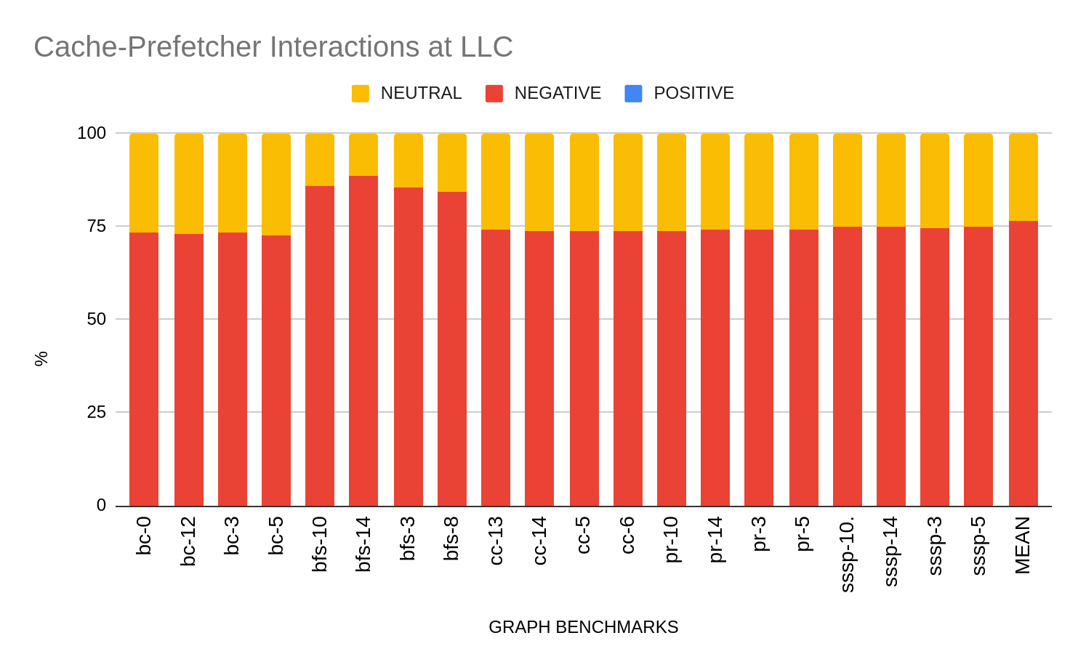
GRAPH BENCHMARKS: SINGLE-CORE
ON AVERAGE
% Positive: 0.031
% Negative: 76.35
% Neutral: 23.62
Prefetcher used at L1D,L2 : IPCP
Replacement Policy at LLC: Hawkeye

Slide 105
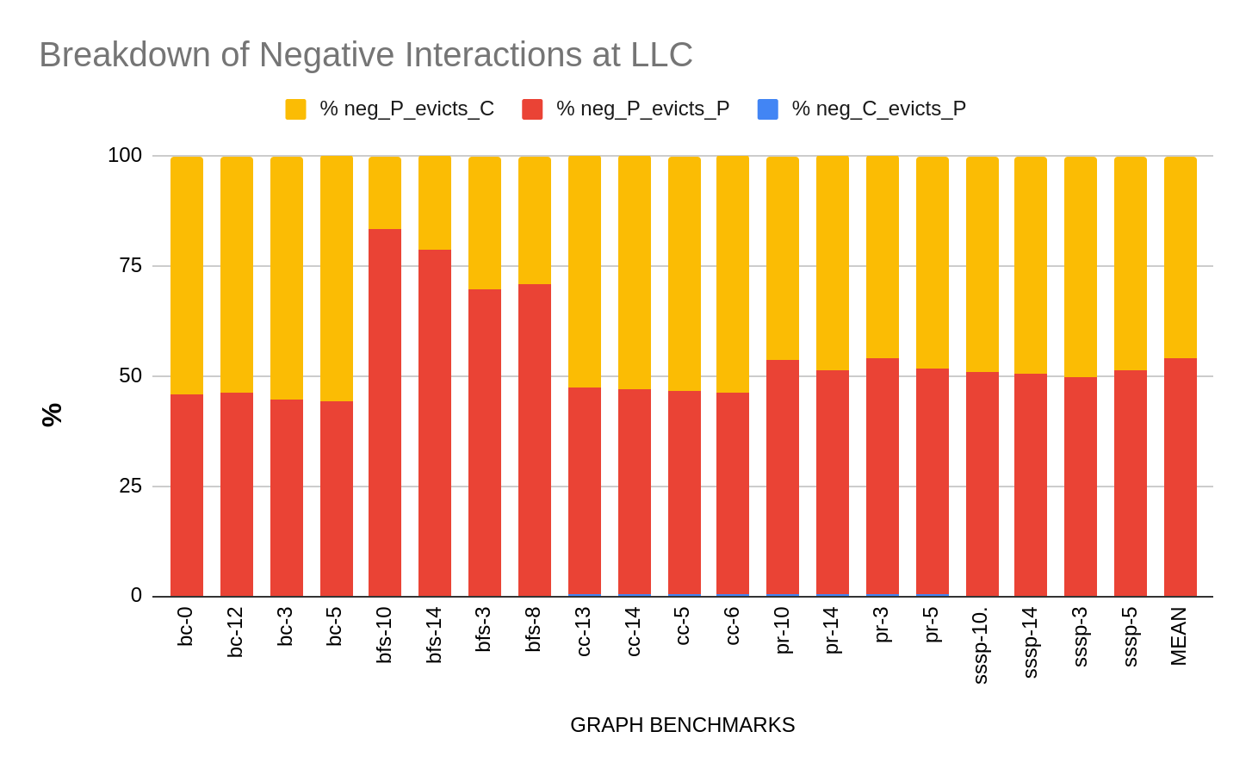
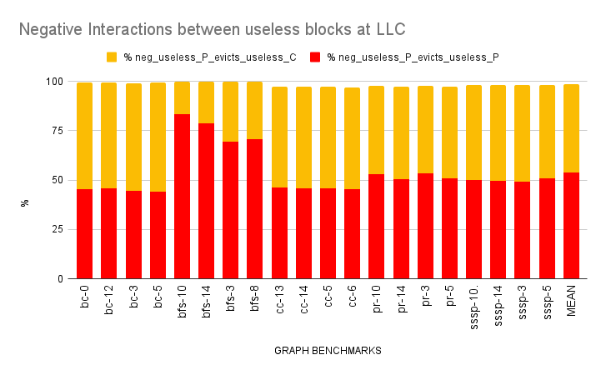
GRAPH BENCHMARKS: SINGLE-CORE
Useless Prefetches evicting dead demand blocks and other useless prefetches make up 98% of total negative interactions (on average)

Slide 106
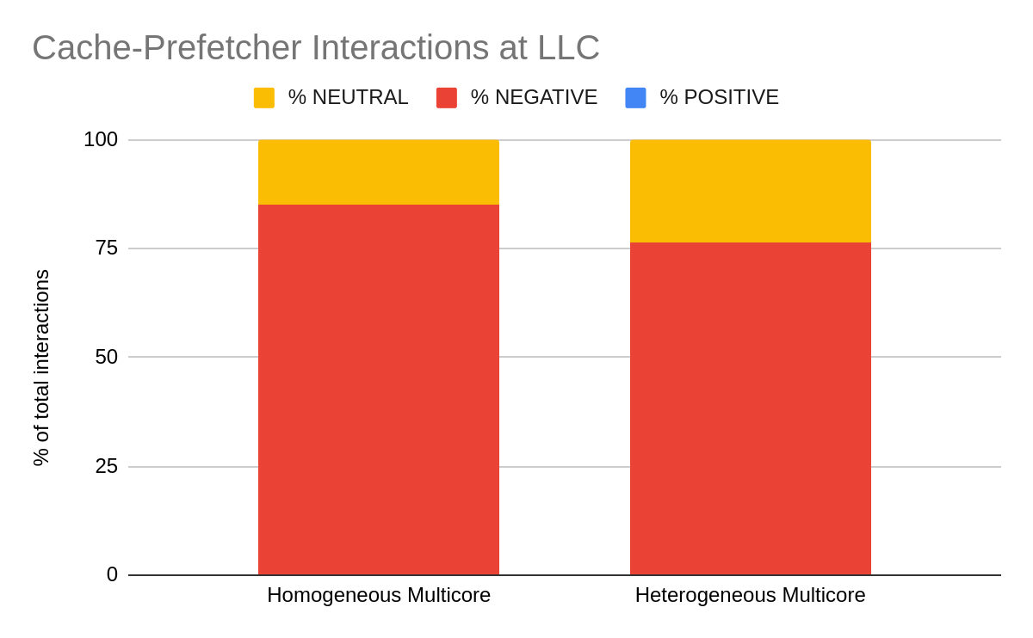
GRAPH BENCHMARKS: MULTI-CORE ( 4 )
Heterogeneous Mix: bc-5, bfs-10, pr-10, sssp-5
Homogeneous Mix: bfs-10
Prefetcher used at L1D,L2 : IPCP
Replacement Policy at LLC: Hawkeye
ON AVERAGE
% Positive: 0.00029
% Negative: 80.6
% Neutral: 19.3

Slide 107
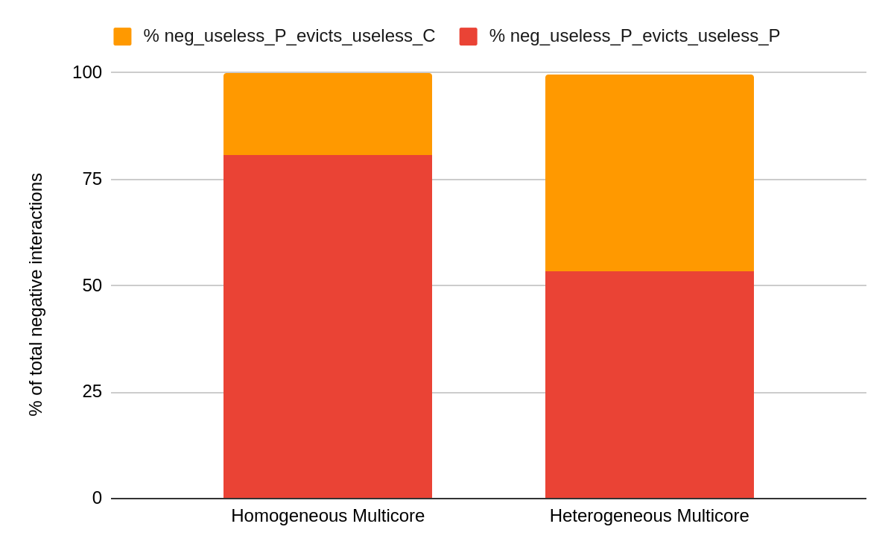
GRAPH BENCHMARKS: MULTI-CORE ( 4 )
Useless Prefetches evicting dead demand blocks and other useless prefetches make up almost 100% of total negative interactions (on average)​

Slide 108
SPEC 2017

Slide 109
Interactions at L1D
Prefetcher used at L1, L2 : IPCP
Replacement policy used at LLC: LRU

Slide 110
Prefetch hit % at L1D
Prefetcher used at L1, L2 : IPCP
Replacement policy used at LLC: LRU

Slide 111
Breakdown of negative interactions(L1D)
Prefetcher used at L1, L2 : IPCP
Replacement policy used at LLC: LRU
Most negative interactions due to useless Prefetches

Slide 112
Interactions at L2C
Prefetcher used at L1, L2 : IPCP
Replacement policy used at LLC: LRU
~80% positive interactions for cactu

Slide 113
Prefetch hit % at L2C
Prefetcher used at L1, L2 : IPCP
Replacement policy used at LLC: LRU
~95 prefetch hit % for cactu

Slide 114
Breakdown of negative interactions(L2C)
Prefetcher used at L1, L2 : IPCP
Replacement policy used at LLC: LRU

Slide 115
Interactions at LLC
Prefetcher used at L1, L2 : IPCP
Replacement policy used at LLC: LRU

Slide 116
Prefetch hit % at LLC
Prefetcher used at L1, L2 : IPCP
Replacement policy used at LLC: LRU

Slide 117
Breakdown of negative interactions(LLC)
Prefetcher used at L1, L2 : IPCP
Replacement policy used at LLC: LRU

Slide 118
Multicore results at L2C
Prefetcher used at L1, L2 : IPCP
Replacement policy used at LLC: LRU
Mix 1: homogenous (607.cactuBSSN_s-3477B)
Mix 2: homogenous (605.mcf_s-1536B)
Mix 3: heterogenous

Slide 119
Breakdown of negative interactions
Prefetcher used at L1, L2 : IPCP
Replacement policy used at LLC: LRU
Mix 1: homogenous (607.cactuBSSN_s-3477B)
Mix 2: homogenous (605.mcf_s-1536B)
Mix 3: heterogenous

Slide 120
Multicore results at LLC
Prefetcher used at L1, L2 : IPCP
Replacement policy used at LLC: LRU
Mix 1: homogenous (607.cactuBSSN_s-3477B)
Mix 2: homogenous (605.mcf_s-1536B)
Mix 3: heterogenous

Slide 121
Breakdown of negative interactions
Prefetcher used at L1, L2 : IPCP
Replacement policy used at LLC: LRU
Mix 1: homogenous (607.cactuBSSN_s-3477B)
Mix 2: homogenous (605.mcf_s-1536B)
Mix 3: heterogenous

Slide 122
SPP

Slide 123
Interactions at L2C
Prefetcher used at L2 : SPP
Replacement policy used at LLC: LRU

Slide 124
Prefetch hit % at L2C
Prefetcher used at L2 : SPP
Replacement policy used at LLC: LRU

Slide 125
Breakdown of negative interactions(L2C)
Prefetcher used at L2 : SPP
Replacement policy used at LLC: LRU

Slide 126
Interactions at LLC
Prefetcher used at L2 : SPP
Replacement policy used at LLC: LRU

Slide 127
Prefetch hit % at LLC
Prefetcher used at L2 : SPP
Replacement policy used at LLC: LRU

Slide 128
Breakdown of negative interactions(LLC)
Prefetcher used at L2 : SPP
Replacement policy used at LLC: LRU

Slide 129
Work done
Analysis of previous results
Sumon: speedup, prefetch hit %, MPKI
Jayati: breakdown of negative interactions

Slide 130
Interactions at LLC
Prefetcher used at L2 : SPP
Replacement policy used at LLC: LRU

Slide 131
Prefetch hit % at LLC
Prefetcher used at L2 : SPP
Replacement policy used at LLC: LRU
Takeaway: High correlation between positive interactions and prefetch hit %.

Slide 132
Interactions at LLC
Prefetcher used at L2 : SPP
Replacement policy used at LLC: Mockingjay

Slide 133
Prefetch hit % at LLC
Prefetcher used at L2 : SPP
Replacement policy used at LLC: LRU
Confirming high correlation between positive interactions and prefetch hit %.

Slide 134
Interactions at LLC
Prefetcher used at L2 : SPP
Replacement policy used at LLC: Mockingjay
Why null interaction for leela?

Slide 135
MPKI at LLC
Prefetcher used at L2 : SPP
Replacement policy used at LLC: Mockingjay
Leela: 0.05 MPKI
Low # of evictions
Does not reach epoch
Implementation flaw: will fix

Slide 136
Performance improvement
Prefetcher used at L2 : SPP
DRRIP: 0.77%
SHIP++: 2.39%
HAWKEYE: 0.86%
MOCKINGJAY: 1.44%

Slide 137
Interactions at LLC
Prefetcher used at L1D,L2 : IPCP
Replacement policy used at LLC: DRRIP

Slide 138
Prefetch hit % at LLC
Prefetcher used at L1D, L2 : IPCP
Replacement policy used at LLC: DRRIP
high correlation between positive interactions and prefetch hit %.
outliers

Slide 139
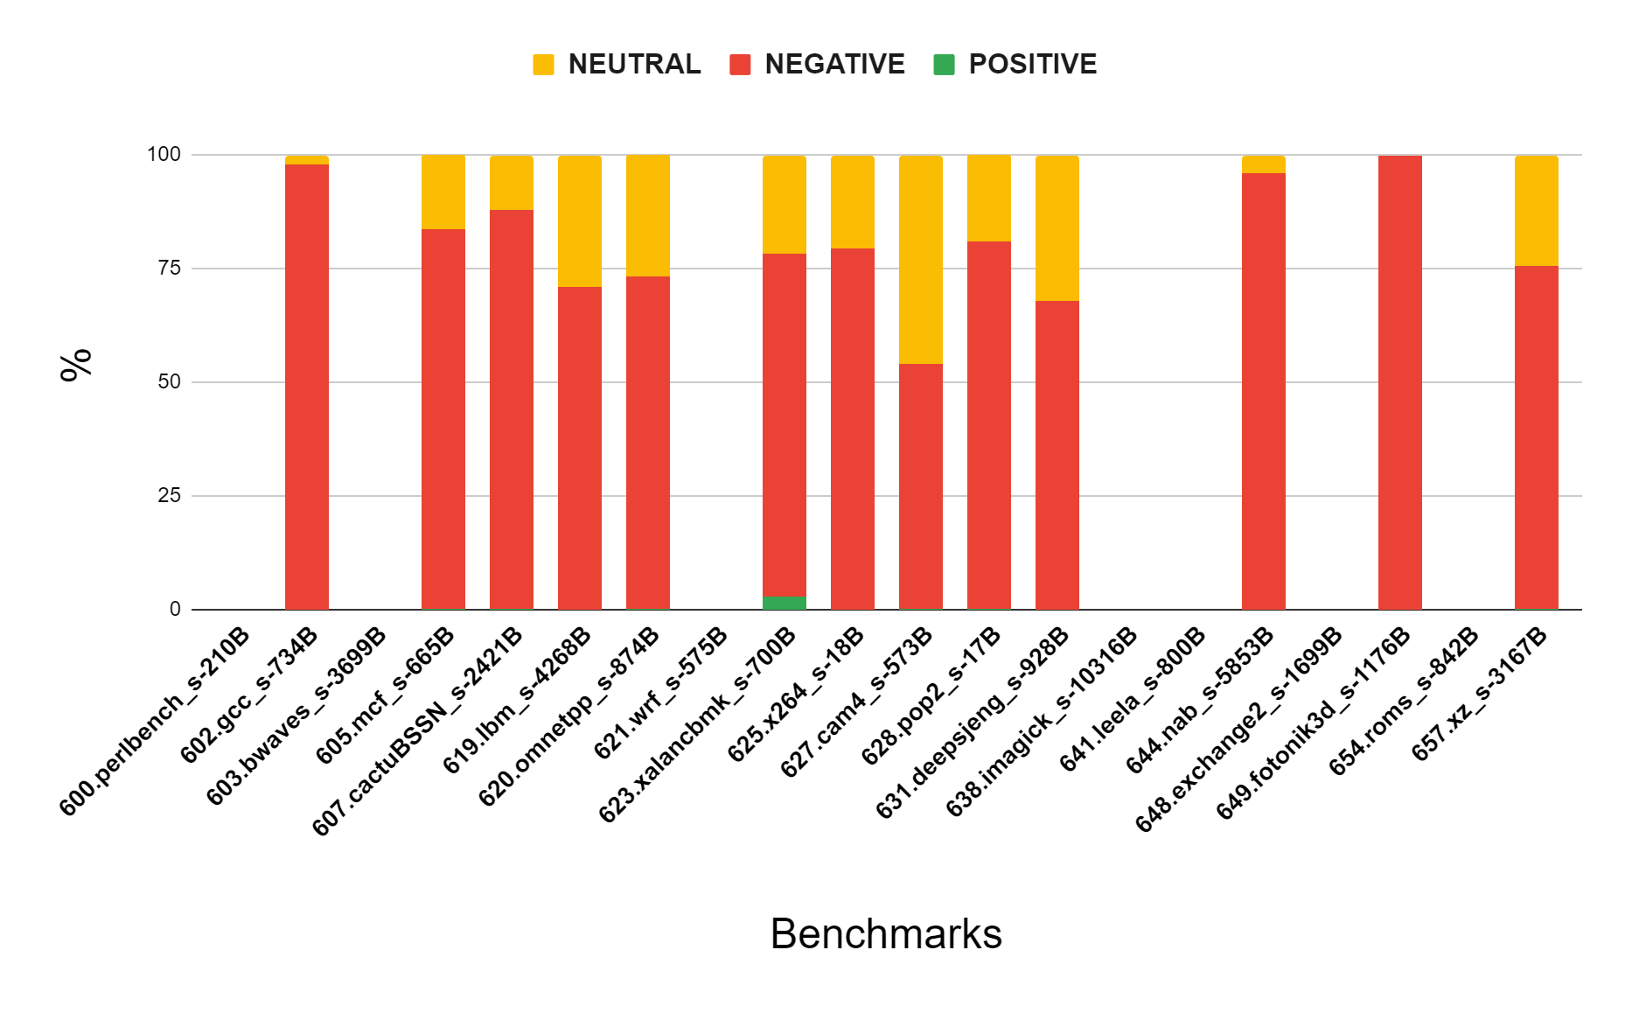
Interactions at LLC
Prefetcher used at L1D,L2 : IPCP

Slide 140
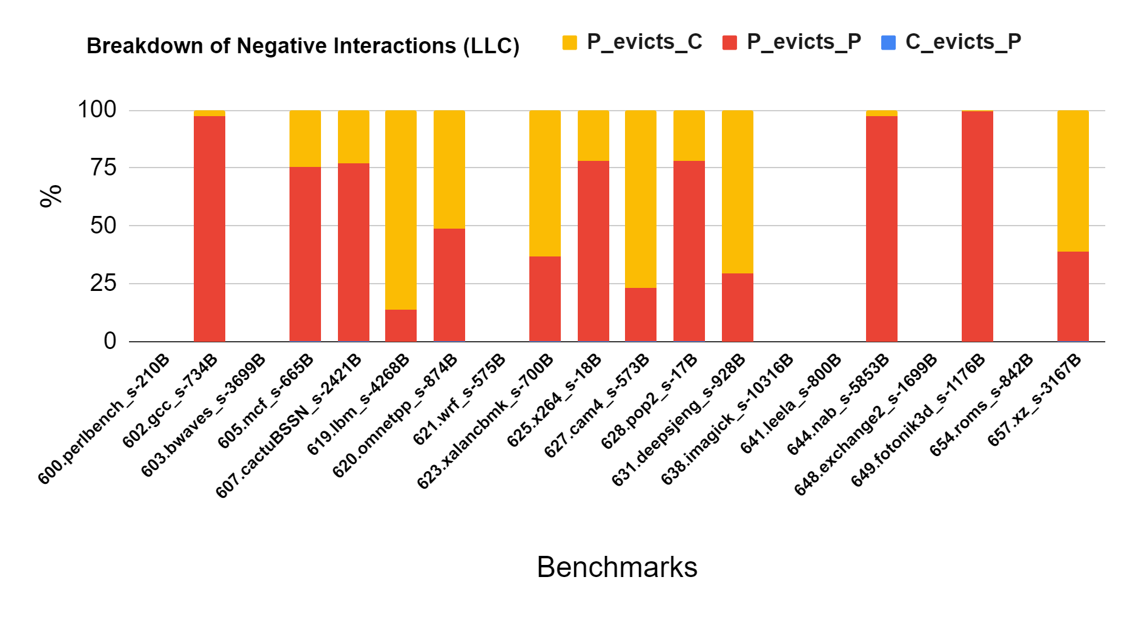
Breakdown of negative interactions
Prefetcher used at L1D,L2 : IPCP

Slide 141
CASPER @ IIT Bombay
Weekly Discussion
Week of Januray 28, 2021
Jayati | Sumon jshrivastava@ee.iitr.ac.in | sumon@cse.iitb.ac.in

Slide 142
Work done
Updated epoch approach to set window size in terms of number of evictions.
Updated epoch approach to use overlapping windows for accurate quantification of interactions.
Carefully observed interaction window & set parameters to get more practical results.

Slide 143
LLC(LRU) with SPP (Updated)

Slide 144
Mockingjay(LRU) with SPP (Updated)

Slide 145
Postive & negative interactions (SPP)
Bench.- SPEC2017
Repl. policies:
L1D - LRU
L2 – DRRIP
High performing replacement policy
More positive interactions
But also increases negative interactions

Slide 146
Postive & negative interactions (IPCP)
Bench.- SPEC2017
Repl. policies:
L1D - LRU
L2 – DRRIP
Strange results!
Guess: problem is useful prefetches for upper level (l1,l2) are identified as negative interactions at LLC

Slide 147
CASPER @ IIT Bombay
Weekly Discussion
Week of Januray 21, 2021
Jayati | Sumon jshrivastava@ee.iitr.ac.in | sumon@cse.iitb.ac.in

Slide 148
Work done
Design & implementation of access window approach to quantify cache interactions.

Slide 149
Idea
Table which stores the interaction as well as all cache accesses.
Is_eviction | Line_1 | Type_1 | Line_2 | Type
1 | A(evicts) | P | X(evicted) | C
0 | X(access)
0 | X(access)
1 | Y(evicts) | C | Z(evicted) | P
At the end of epoch
Parse table to record interaction

Slide 150
L1D(LRU) with IPCP

Slide 151
L2C(LRU) with IPCP

Slide 152
LLC(LRU) with IPCP

Slide 153
LLC(Hawkeye) with IPCP

Slide 154
next : SPP

Slide 155
L2C(LRU) with SPP

Slide 156
LLC(LRU) with SPP

Slide 157
LLC(Hawkeye) with SPP

Slide 158
CASPER @ IIT Bombay
Weekly Discussion
Week of Januray 14, 2021
Jayati | Sumon jshrivastava@ee.iitr.ac.in | sumon@cse.iitb.ac.in

Slide 159
Work done
Ran more experiments with different prefetcher and replacement policies.
Understood the mechanism of KPC(kill the pc)[1].
[1] Kim, Jinchun et al. “Kill the Program Counter: Reconstructing Program Behavior in the Processor Cache Hierarchy.” Proceedings of the Twenty-Second International Conference on Architectural Support for Programming Languages and Operating Systems (2017)

Slide 160
KPC-Prefetcher
Works at the L2
Signature based look-ahead mechanism
Uses path confidence(C_{n}) for throttling & prefetching decision
Uses C_{n} to decide fill level by comparing fill level threshold(T_{F})

Slide 161
KPC-Replacement policy
Works at the LLC
Uses set dueling mechanism
Uses dead block prediction for both demand & prefetch blocks.
Updates T_{F} by learning LLC fill pattern.

Slide 162
More experiments
Prefetchers used: IPCP & SPP
Replacement policies used: LRU, Hawkeye, Ship++
Benchmarks: SPECCPU 2017

Slide 163
Results at L1D with IPCP & Hawkeye(at LLC)
9%, 10%, 81%
Similar results with LRU & Ship++

Slide 164
Results at L2C with IPCP & Hawkeye(at LLC)
~9%, 9%, 82%
Similar results with LRU & Ship++

Slide 165
Results at LLC with IPCP & LRU(all levels)
2%, 7%, 91%

Slide 166
Results at LLC with IPCP & Hawkeye(at LLC)
2%, 18%, 80%
-ve interaction increases from 7% to 17%

Slide 167
Results at LLC with IPCP & Ship++(at LLC)
2%, 22%, 76%
-ve interaction increases from 7% to 22%

Slide 168
Results at L2C with SPP & Hawkeye(at LLC)
37%, 3%, 60%
Large % of +ve interactions compared to IPCP
Similar results with LRU & Ship++

Slide 169
Results at LLC with SPP & LRU(all levels)
33%, 16%, 49%

Slide 170
Results at LLC with SPP & Hawkeye(at LLC)
25%, 17%, 57%
-ve : 16% to 17%
+ve: 33% to 25%

Slide 171
Results at LLC with SPP & Ship++(at LLC)
23%, 18%, 58%
-ve : 16% to 18%
+ve: 33% to 23%

Slide 172
CASPER @ IIT Bombay
Weekly Discussion
Week of Januray 7, 2021
Jayati | Sumon jshrivastava@ee.iitr.ac.in | sumon@cse.iitb.ac.in

Slide 173
Work done
Implementation of dead block predictor & mechanism to calculate dynamic prefetcher accuracy.
Quantification of interaction between prefetched blocks and cache blocks at the time of eviction.

Slide 174
Dead block predictor
3-bit global hysteresis counter used in Kill the PC[1]
Increment counter on cache miss
Decrement counter on cache hit
Predict block is dead when the counter saturates
[1] Kim, Jinchun et al. “Kill the Program Counter: Reconstructing Program Behavior in the Processor Cache Hierarchy.” Proceedings of the Twenty-Second International Conference on Architectural Support for Programming Languages and Operating Systems (2017)

Slide 175
Prefetch hit predictor
Have implemented the approach in Feedback Directed Prefetching[2], yet to be integrated.
For now, we have used the same mechanism as dead block predictor using a global counter.
[2] S. Srinath, O. Mutlu, H. Kim and Y. N. Patt, "Feedback Directed Prefetching: Improving the Performance and Bandwidth-Efficiency of Hardware Prefetchers," 2007 IEEE 13th International Symposium on High Performance Computer Architecture, 2007

Slide 176
Type of interactions
Positive (+)
P evicts C
C evicts P
P evicts P
Negative (-)
P evicts C
C evicts P
P evicts P
Neutral (0)
P evicts C
C evicts P
P evicts C
C evicts P
P evicts P
P evicts P
* P predicted accurate
P predicted inaccurate
C predicted dead
C predicted not-dead

Slide 177
Distribution of interactions for IPCP
Cache level: L1
LRU at all levels
* need to see the distribution of each kind of interaction, to get a better idea.

Slide 178
Negative interactions L1D

Slide 179
Distribution of interactions for IPCP
Cache level: L2
LRU at all levels

Slide 180
Negative interactions L2C

Slide 181
Distribution of interactions for IPCP
Cache level: Last level
LRU at all levels

Slide 182
Negative interactions LLC

Slide 183
What Next ?
To measure the accuracy of dead block predictors and prefetcher hit/no-hit predictor.
To run more experiments(on all benchmarks, with more instructions).
To find performance improvement when -ve interactions are eliminated.

